Slide 1
Welcomes You Today

Slide 2
The United Nations declare this is the “Decade of Action for Road Safety”. The MOST dangerous activity an employer typically ever asks an employee to undertake is driving on company business. The European Transport Safety Council estimate that business drivers account for 40% of road deaths across Europe.

Slide 3
Fleet Risk Management
With Underwriting and Customer Experience

Slide 4
Areas to be covered
Learning Objectives
Introduction
Road Risks and the Law
Current Marketplace
Compliance
Sales Opportunities
In Car Technology
New Developments
Driver Behaviour

Slide 5
Learning Objectives
Understand the Duty of an Employer in relation to Work Related Road Risks
The Legal Position
Who is responsible
Added Value - Applying the knowledge to assist clients be Legally Compliant
What the client facing opportunities are
Future Developments

Slide 6
Jim Bowles AICFM ACII Chartered Insurance Practitioner
44 years experience in the UK Commercial Insurance market
At the forefront of Risk Managed Underwriting approaches to Motor Fleets for over 20 years
Designed and managed profitable Motor Fleet schemes/facilities
Some of the roles held with Norwich Union and NIG include - Area Underwriting Manager/Strategic Account Manager/Project Manager
Experience of all distribution channels
Currently working with a number of Brokers to improve their customers fleet compliance and management of fleet risk
Qualified advanced driver and observer
Institute of Motor Industry (IMI) recognised observer
Fleet Legal Compliance Auditor

Slide 7
Why did I create Velocity Scotland Limited (VSL)?
Some insurers think they know what Fleet Risk Management is
Solutions are work intensive for client
Directed at what suits their underwriting
Health and Safety Consultants
Invariably don’t include the Work related Road Risk (WRRR)

Slide 8
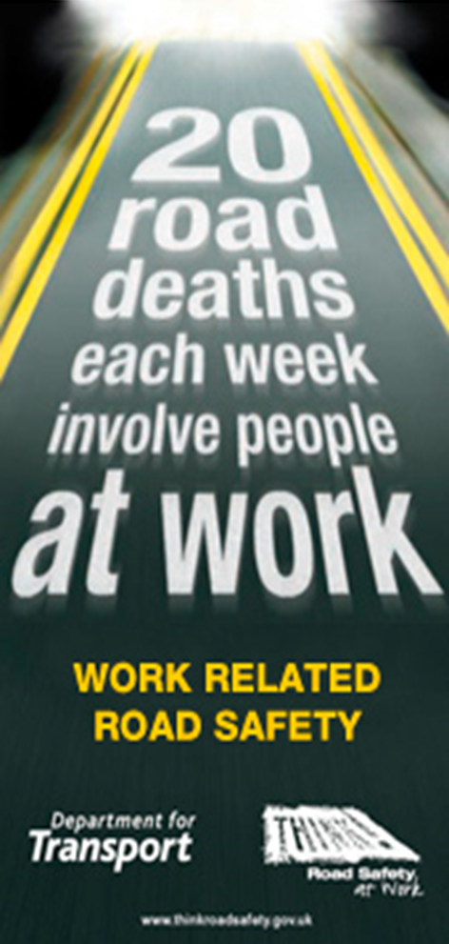
Why manage road risks?
Driving at work
20 deaths per week (DfT)
250 serious injuries per week (DfT)
6 out of 10 work related deaths (IOSH)
40% of road deaths across Europe (ETSC)
Over 25k per annum -1 in 8000 chance of death
Same risk factor as faced by miners (ROSPA)
Driving is typically the most dangerous activity an
Employer ever asks an employee to undertake

Slide 9
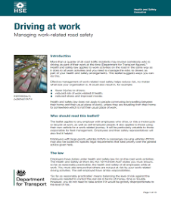
The Law
The Health and Safety at Work Act 1974
Your duty to ensure the H&S of all employees
Risks arising from their work
Proposals to manage and / or control these risks
The best ways to provide information and training
As well as not putting the H&S of others at risk by your work related driving activities
HSE recommendations – ‘Driving at work Sept 2003’
Driver / Journey / Vehicle
Penalty – Guide 10% of T/O and Publicity order

Slide 10
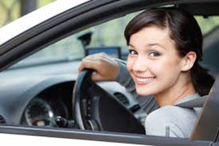
Duty of Care rules apply to everyone
HSE guidance makes no distinction regarding ownership.
Applies to all driver types:
Company
Hire
Pool
Borrowed
Employee owned – The so called ‘Grey Fleet’
Cash allowance
Claiming expenses for Business Mileage
The cashier going to the bank in their own car

Slide 11
Which Laws Apply?
Health and Safety at Work etc. Act 1974
AND
Road Traffic Act 1988

Slide 12
The Law – Corporate Liability
Section 2 – Duty to the Employees
Duty to “ensure” the Health, Safety and Welfare of Employees
Section 3 – Duty to “Non” Employees
Duty to “ensure” the Health & Safety of Non Employees
As Far as Reasonably Practicable

Slide 13
Corporate Manslaughter and Homicide Act 2007
Offence:
Organisation is guilty if the way in which its activities are managed or organised causes a persons death and amounts to a gross breach of a relevant duty of care owed by the organisation to the deceased, only if the way in which its activities are managed by senior management is a substantial element of the breach
Penalty:
UNLIMITED FINE (potentially millions of £’s) & Publicity Order:
New sentencing guidelines – anything from £180k to £20 million pounds depending on seriousness of offence and size of organisation. Negative Publicity Order included

Slide 14
Corporate Manslaughter & Homicide Act 2007
Areas for dispute (so important to get right!):
Grossness of the Breach
Compliance with law / standards / guidance
Safety Management System
Organisation’s safety culture
Role of senior management
Collective failings
Effective delegation, empowerment and accountability

Slide 15
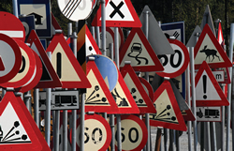
Line Manager Engagement
All risk assessments, whether road risk or workplace risk, must be carried out by someone who:
Is competent to do so (i.e. skills, knowledge and experience
Involves staff and drivers in the process
Understands when specialist help may be needed
Notes:
Assessing risks on the road
Employer are responsible for assessing the risks to health and safety in their business. Risk assessment for any work-related driving activity should follow the same principles as for any other work activity. They can delegate the task, but will need to make sure it is carried out by someone who:
is competent to do so (has the right skills, knowledge and experience);
involves your workers in the process;
understands when specialist help may be needed.
Risk assessment is about identifying and taking sensible measures to control the risks in your workplace, not about creating huge amounts of paperwork. You may already be taking steps to protect your employees, but your risk assessment will help you decide whether you should be doing more. The aim is to make the risk of someone being injured or killed as low as possible. See the HSE website (www.hse.gov.uk/risk) for more information.
A hazard is something in your business that can cause harm. A risk is the chance, however large or small, that a hazard could cause harm.
Identify the hazards
Look for hazards that may result in harm when driving on public roads. Remember to ask your employees, or their representatives, what they think as they will have first-hand experience of what happens in practice.
You need the views of those who drive extensively, but also get the views of those who only use the roads occasionally. The main areas to think about are the driver, the vehicle and the journey. See the ‘Work-related road safety checklist’ for some suggestions about what to consider.
Who might be harmed?
Decide who might be harmed and how. This will usually be the driver, but it might also include passengers, other road users and/or pedestrians. Also consider whether there are any groups who may be particularly at risk, such as those new to the job and those driving long distances and working long hours.
Evaluate the risks
Having identified the hazards, decide how likely it is that harm will occur. You are not expected to eliminate all risks, but you must make sure you know about the main risks and how to manage them responsibly. You need to do everything reasonably practicable to protect people from harm.
Record your findings
Record your significant findings – make it simple and focus on controls. If you have five or more employees, you are required by law to write it down. If you have fewer than five employees you don’t have to write anything down, but it is good practice to keep a record. An easy way to record your findings is to use HSE’s risk assessment template: www.hse.gov.uk/risk/risk-assessment-and-policy-template.doc. This also includes a section for your health and safety policy.
Regularly review your risk assessment
It makes sense to review your risk assessment on a regular basis. There is no set frequency for carrying out a review, but you need to ensure that the risks to those who drive, and others, are suitably controlled.
For this to be effective you need to know about any road incidents, your drivers and vehicle history. Changing circumstances may also prompt a review, eg introducing new routes, new equipment or a change in vehicle specification. If anything significant changes, check your risk assessment and update it.

Slide 16
Hazard & Risk
A hazard is something in your business that can cause harm.
A risk is the chance, however large or small, that a hazard could cause harm.

Slide 17
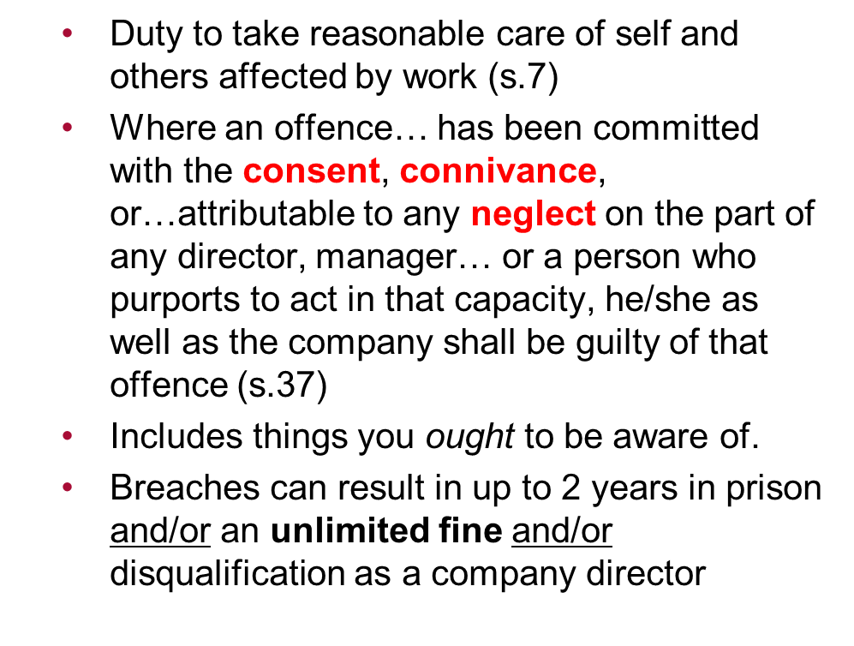
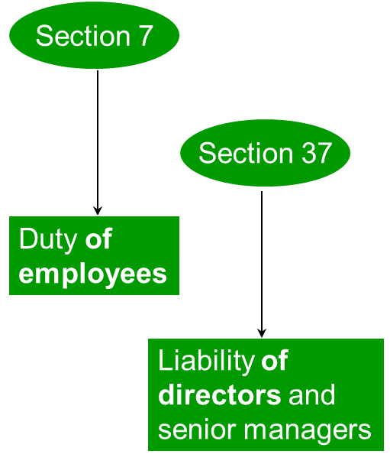
Individual Liability
Notes:
Neglect can include a failure to deal with things they ought to have been aware of even if not actually aware
explain how this is application to Fleet Manager, Transport Managers and Operators

Slide 18
Have you met the people who could be liable?
Transport Manager
Production Manager landed with the company vehicle programme
HR Manager
MD of a business
MD of an Insurance Brokerage

Slide 19
Individual Liability
Drivers should also exercise care as any reasonably prudent, careful and competent driver… nor drive in a way that falls far below the standard expected or that is obviously dangerous in the circumstances…Road Traffic Act 1988 / Road Safety Act 2006
DRIVER ACCOUNTABILITY:
Causing death by Dangerous driving / Careless driving
Careless driving (Driving without due care and attention)
Causing serious injury by dangerous driving
Driving with Excess Alcohol
Drug Driving

Slide 20
Current Marketplace
Carriers
Use contractors but do they have Legally Compliant Fleets?
Won`t insure a contractor that doesn’t have a Health & Safety Policy for Liability Insurance but will insure their fleet which is not Legally Compliant?!
Health and safety consultants admit they don’t discuss fleet compliance
Brokers in general don`t see this as part of their job

Slide 21
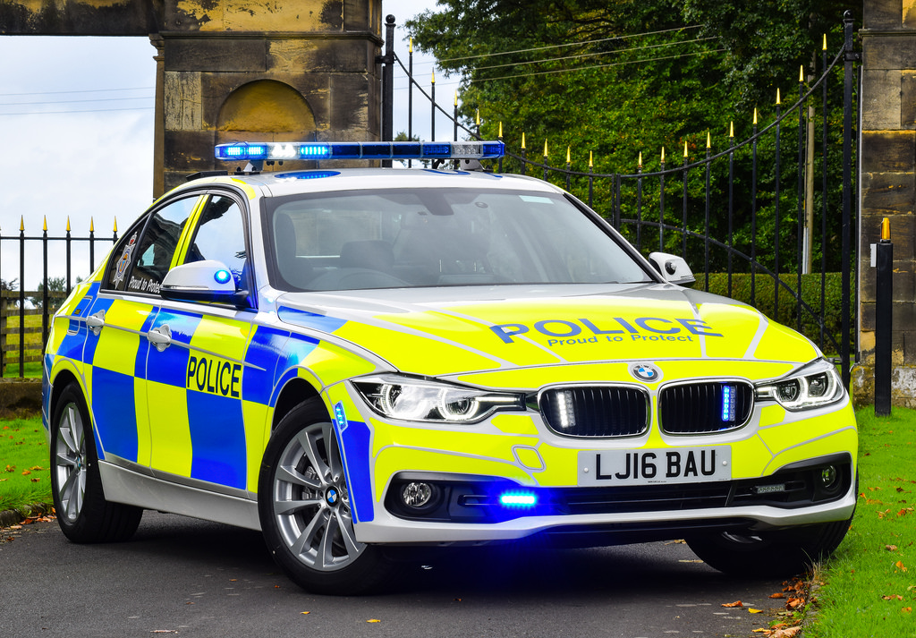
Current Marketplace
Businesses
Don’t know about Legal Compliance which has the potential to ruin them
Has an idea but too busy to do the work
Uses telematics for speeding events only ignoring the other data which the Police can download and use against them for a prosecution
Don’t care as it will never happen to them
Any one of these could be YOUR current or Prospective customer

Slide 22
Fleet Compliance Audits
Driver
Journey Management
Vehicle
Notes:
Bus with air conditioning unit
Travelling in sleep zone – Insurance Broker
Journey & Weather conditions - EF

Slide 23
What does a Compliant System look like
Driver Risk Assessments
Risk Identification and Mitigation Program
Licence Checks
Fitness to Drive
Grey Fleet Checks
Age and Type of car in keeping with fleet policy
Service record
MOTs
Insurance certificate including Business Use including indemnity to employer
Notes:
Safety features, age, number of doors etc

Slide 24
What does a Compliant System look like
Journey Management
Vehicle selection
Telematics analysis
Tachograph analysis
Camera data analysis
Mobile Phone policy
All Contained within
A Fleet safety Policy
Fleet Drivers Handbook
Notes:
Fleet safety documents to be signed by driver and constantly reviewed
Highway code
Apps

Slide 25
Benefits
Legally compliant
Reduction in Accident frequency
Excess savings
Proven claims and hidden cost savings
Manage future Insurance Premiums
Protect Brand reputation
Employee welfare
Fuel and running cost savings

Slide 26
How accidents impact on business
In order to fund their annual uninsured losses of their European Fleet, Nestle
have to sell an additional 235,000,000 Kit Kats !
In addition to other implications:
Brand reputation
Absenteeism
Lost productivity
Customer service
Employee welfare

Slide 27
How accidents impact on business
Every hour, a person goes blind
Introducing a Risk Management Programme:
Resulted in a 50% saving in annual claims costs – £125,000
Equivalent to 2.5 more dogs per annum being delivered
to blind customers!

Slide 28
Work Related Road Risks (WRRR)
Very rarely addressed by Brokers – do you have a compliant checking system in place to avoid Prosecution and a possible fine and/or a prison sentence?
Not widely established in businesses
Corporate Manslaughter potential hence compulsory protection and an area a broker would be expected to discuss – it`s Employers Liability after all
Health and Safety Practitioners invariably do not address the WRRR
Are YOU carrying out “at work” journeys?
Clients staff carrying out “at work” journeys
Grey Fleet drivers
Volunteer Drivers for charities
Fair Representation of your client and advice, are you open to PI exposures if you do not discuss and provide WRRR solutions?

Slide 29
How can you use this knowledge?
A New Business Tool and increased client retention – becoming more of a Partner Business Consultancy than an Insurance Capacity Provider/Broker
Adds value when rate increases hit and customers question rising costs
Risk Reduction Solution – Case review and provision of compliant fleet solution
Review existing client base to establish exposures and implementation of solutions improving retention rate
Review pipeline and provide fleet compliance options others will not consider
Claims and Telematics analysis and risk review

Slide 30
In Car Technology to assist drivers
It is important to remember that these are driver assistance systems, and are designed to support the driver. Not replace them. You are ultimately responsible and liable. So, do not over rely on them and make sure that you are 100% in control of the vehicle at all times

Slide 31
Active safety features
Anti-lock Braking
Traction Control
Electronic Stability
Autonomous Braking
Lane Keeping

Slide 32
Passive Safety Features
Seat Belts
Head Restraints
Airbags
Crumple Zones

Slide 33
In Vehicle Technology
Active Park Assist
Voice Control
Traffic Sign Recognition
Advanced Front Lighting
Speed Limiting

Slide 34
Active and Passive Safety Devices
Active safety features
help to prevent or mitigate road crashes.
Passive safety features
help to protect vehicle occupants from further injury once a crash has already occurred.
In vehicle technology
makes the task of driving easier for the driver.

Slide 35
Vehicles are undoubtably safer now
What about new developments?

Slide 36
Autonomous Vehicles
The Society of Automotive Engineers has defined six levels of automated driving, ranging from SAE Level 0, a fully manual car, up to Level 5, fully autonomous. Level 2 cars are already out there – able to brake, accelerate and steer in certain situations, but with a supervising driver ready to take back control immediately.
Various stages of development with the occasional set back
All seem to revert to the driver being in ultimate control when things don’t go quite according to plan

Slide 37
Other Developments
Telematic Apps including
FNOL
Vehicle checks (POWDERY)
Duty of Care
Blood Tests for sleep deprivation
Telematics/Cameras in ALL vehicles
Smart cameras on the roads

Slide 38
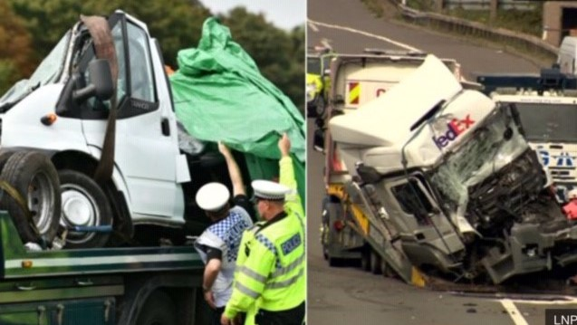
The Driver
All assessments in place and vehicle provided with all the modern safety features and this happens:

Slide 39
Bad behaviour can give you wings

Slide 40
Autism school 'devastated' after staff members killed in minibus crash
The M4 was closed for nine hours as police investigated a collision between a lorry and a minibus that killed three people.
The minibus driver - a member of school staff – died, Thames Valley Police said.
Two other members of staff were pronounced dead at the scene on the M4, while a further two are in a critical condition in hospital.
Three young people travelling in the minibus were on their way back from a work placement. One required surgery on their leg, while the other two escaped with minor injuries.
"No one has been arrested at this time," said Inspector Andy Storey.
"The ongoing investigation will seek to establish what happened in this tragic incident."

Slide 41
A Compliant System protects against driver behaviour
The Law states
As Far as Reasonably Practicable

Slide 42
Fleet Compliance Checklist
Do they have a robust driver policy that is reviewed regularly and given to employees
Do they have a Drivers Handbook
Are Driving Licence checks completed for all employees who drive for your business
Vehicle document checks (Servicing, MOT and insurance) for those who do not use a company owned/leased vehicle
Do they have a reliable, auditable system for assessing each individual driver’s risk level
Are Training programmes in place to address the needs of drivers deemed to be high-risk

Slide 43
Not Compliant – It will never be Business as Usual

Slide 44
Learning Objectives -Checklist
Understand the Duty of an Employer in relation to Work Related Road Risks
The Legal Position
Who is responsible
Added Value - Applying the knowledge to assist clients be Legally Compliant
What the client facing opportunities are
Future Developments

Slide 45
Questions

Slide 46
Thank you for your time

