Slide 1
Indemnity Periods
Insurance Institute of Halifax 25 April 2019

Slide 2
Introduction
Aim of the policy
MD provides cover for physical assets
Provides cover for financial health

Slide 3
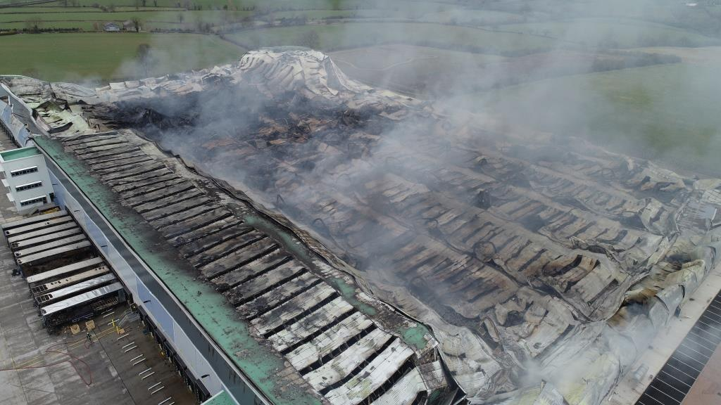

Slide 4
Your position
Your aim – get it right
You are selling
You are the expert
You are exposed
Your friendship or your money

Slide 5
Fixing cover
Machinery – What did you pay
When, Where, Brexit
Tangible
BI – How long to get your business back to normal
Café De Lecq

Slide 6
Why work harder?
Declaration linked – avoids average
But get it right
Loss of revenue instead of GP
Retail aside
Additional increased cost of working

Slide 7
Jargon
Period of interruption
Maximum indemnity period
How long will it take you to fully recover
How long do you want to be protected for

Slide 8
Period of interruption
Results shall be affected
Like marriage – for better or worse
Can be difficult to agree start if subs
Longer out of the game, the longer disproportionately to get back in
Far better if ICW lead – money the solution

Slide 9
Clichés
In a worst case scenario, if this place burnt to the ground I could rebuild in a year
12 months is too short
There are plenty of other places round here
I could easily replace that second hand

Slide 10
Worst case scenario
Total loss is not worst case scenario
Significant partial loss is
Machinery: site issues, lead times, spares
Buildings: planning, neighbours, listed
Practicalities – landlords, green, flood

Slide 11
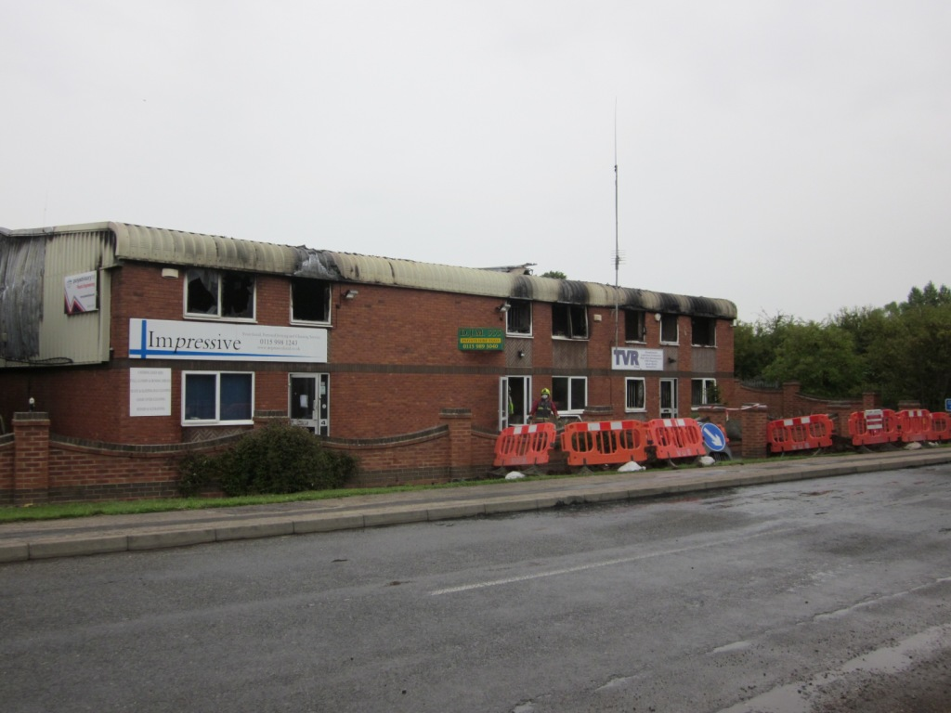

Slide 12
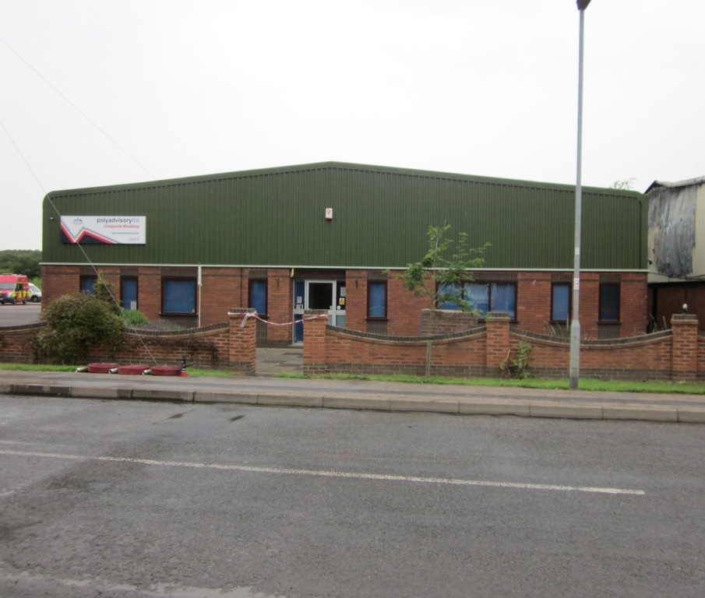

Slide 13
Worst case scenario
Total loss is not worst case scenario
Significant partial loss is
Machinery: site issues, lead times, spares
Buildings: planning, neighbours, listed
Practicalities – landlords, green, flood

Slide 14
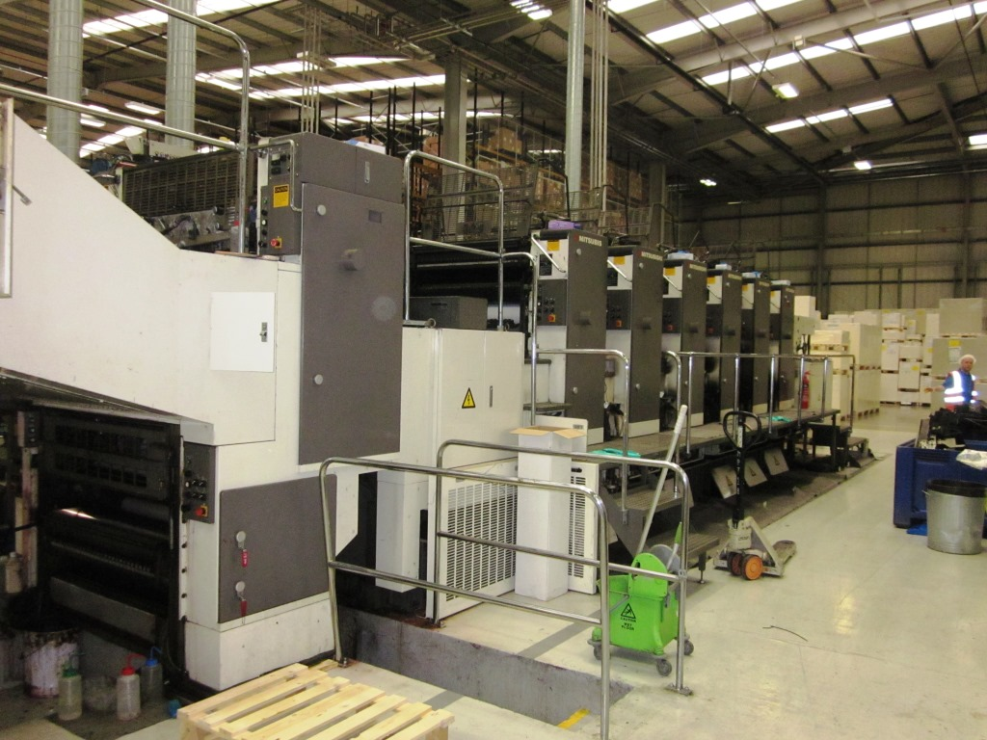

Slide 15
Competence of management
Like driving – overestimate ability
Haven’t experienced reality
Staff relationships – expect a lot from them
Key personnel are attractive to competitors

Slide 16
12 months – more or less
Services
Manufacturing
Retail/leisure

Slide 17
Services
One fixed office - a thing of the past
Different worst case scenarios
Fleet of foot by nature, USP built on it
Homeworkers, dispersion
Back up ICT/cloud
GP needed to intangible services?
Keep GP for tangible services eg dentist or estate agent

Slide 18
Manufacturing
Range of businesses, heavy industry to low value sub assembly
Subcontract out/overtime – but enough flex or capacity, concurrent seasonality
Maintain the facade of BAU
Capex, fines, obsolescence, lead times
Ongoing partial loss often overlooked
Customer defection, much longer to recover

Slide 19
Retail/ Leisure
It’s bad to move
Extreme competition
Inertia/reluctance to return
Licensing of premises
Ferraris and Nandos
One size does not fit all

Slide 20
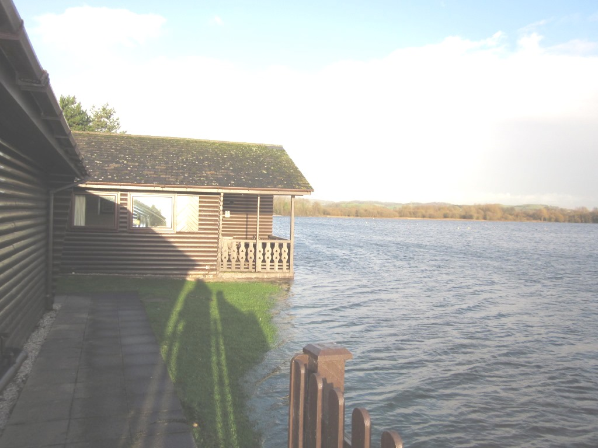

Slide 21
Supply chains
Remember: we are all clients and customers
Contract penalties
Sole exposure clients appreciate
More diverse concerns

Slide 22
Social media
Take control, or someone else will
Silence: the best policy sometimes
Incredibly fast
Facts dispel myths but myths can kill
Be honest and realistic

Slide 23
Remember
Total loss is not the worst case
Ongoing partial loss
Disconnect between pre loss optimism and reality
Compliance

Slide 24
Your turn
Any Questions?

