Slide 1
Insurance Distribution Directive

Slide 2
Alan Chandler, Chartered Insurer
I have trained more than 1,000 individuals to become ACII qualified
I have trained over 50% of the individuals in the last 8 years that have gone onto achieve the highest ACII pass in the whole of the UK.
I train to a pass rate of more than 96% in all CII qualification levels. Certificate , Diploma and Advanced Diploma.
I deliver the Allianz scholarship and academy programmes in both the UK and Ireland and I have been a Cii examiner.
I have trained students who have won national prizes in almost all ACII subjects including Insurance Law (MO5), Liability (M96), Commercial Property and BI (M93), Personal Lines Insurance (P86), Business and Finance (M92), Underwriting Practice (M80), Advanced Underwriting (960), Claims Practice (M85), Advanced Claims (820), Marketing (945), Advanced Broking (930) and Advanced Risk Management (992).

Slide 3
Objectives
Understand the background and why IDD is being implemented and when
Who it applies to
Describe what the changes are
Explain the impact on general insurance firms and the impact on customers
Describe what firms should be doing in preparation for the changes

Slide 4
To start…
The Insurance Distribution Directive (IDD) is one of the most significant changes in Insurance regulations in 10 years
Firms need to understand the changes and have plans in place to implement the changes
It comes into force on 1 October 2018

Slide 5
It was due on 23rd Feb but….
Many countries still not prepared and asked for delay
New date of 1st July for each country to publish their rules
New date of 1st October 2018 for implementation
Notes:
Why is the IDD important?
It introduces rules on the development and distribution of new insurance policies whereby policies have to be tested before launch, distributors receive suitable training material and the policies produce the intended results. Guidance existed before but now we will have rules. (RPPD)
Requirement for all in the chain to act honestly and professionally in the best interest of the customer.
Written conflicts of interest policy with annual report to the board
Change in the definition of advice

Slide 6
The IDD
It replaces the Insurance Mediation Directive
Mediation becomes Distribution
Its aim is to:
Create a level playing field for insurance intermediaries and the distribution of insurance
Harmonise regulation across the EU
Aim is to improve professional standards in the insurance market across Europe
Raise standards of conduct
Improve competition
Improve customer protection

Slide 7
Background
The Insurance Mediation Directive mainly applied at point of sale, and didn’t cover product design and distribution
Didn’t directly cover Price Comparison Sites (though we did in the UK)
More firms involved in the insurance process rather than just broker/client or policyholder dealing direct with the Insurer

Slide 8
Example - the chain
Policyholder
Aggregator
Intermediary
Managing general agent
Insurer
Notes:
This emphasises how many people can be in the chain
Some time there are sub brokers as well
By the time the policy holder gets the policy form the Insurer there are quite a few mouths to feed

Slide 9
Insurance Distribution Directive
Applies to Consumer and Commercial Customers
Applies to Insurers
Applies to Wholesalers
Applies to Garages and Shops that sell Insurance as an ancillary to their main business rather than just pass on leads
Notes:
Applies to all.

Slide 10
Insurance Distribution Directive
There is a lot for firms to do
Notes:
IPID
Disclosure of where commission comes from and whether insurance company sales staff receive bonuses
Conflicts of interest – whether acting for insurer or customer
Must always act in the best interests of the customer
Disclosure of whether advice or advice on a fair and personal recommendation – or no advice
Record keeping
“Good repute” may mean criminal record checks for all staff
Cross selling – where 2 products sold together and one is not insurance, one must be optional
Requirement to act always in the best interest of the customer and will include wholesalers who conclude contracts
Product governance rules including value for money and appropriate training for distributors
15 hours CPD
Marketing material must be identified as such
Changes on rules on introducers
Disclosure of names of all insurers where advice is not on a fair and personal analysis of the market
PERG 5.16.2. says The MERE provision of data and information on potential policyholders to insurance intermediaries, reinsurance intermediaries, insurance undertakings or reinsurance undertakings where the provider does not take any additional steps to assist in the conclusion of an insurance or reinsurance contract; does not constitute insurance distribution. The FCA say (PERG 5.6.4C) it covers those situations where a person provides EXISTING information they hold on potential policyholders ( for example their name and contact details) but does not extend to information they obtain from other means such as pre-purchase questioning. Can a broker get rid of its IARS? Each case is ;likely to be different. The easiest case is if an existing organisation had a membership list, it could pass it to a broker and receive payment without being an IAR. ( GDPR however means they would need specific informed consent and all that entails.

Slide 11
Insurance Distribution Directive
Changes to disclosure – Terms of Business and scripts for Commercial AND Consumer Customers
You must disclose the source(s) of your income
You must disclose the type of remuneration

Slide 12
Insurance Distribution Directive
Changes to disclosure – Terms of Business and scripts for Commercial AND Consumer Customers
For example you must disclose that any commission you receive from an insurer is taken from the customers’ Premium
You must disclose all other sources of income (Profit Share, Premium Finance, etc.)

Slide 13
Insurance Distribution Directive
Changes to disclosure – Terms of Business and scripts for Commercial AND Consumer Customers
Fees must be disclosed in cash terms
Fees of “up to” are not allowed (FCA rule)
Other Fees, for example Mid-Term Adjustments and Cancellation must be disclosed in cash terms (or explain how they will be calculated)
There are a number of ways you can do this. For instance in your terms of business you can say “Insurers pay us a commission which is a percentage of your premium and in addition we charge a policy set up fee of £30 and mid term adjustment fee of £25. We also charge £25 if you cancel your policy.

Slide 14
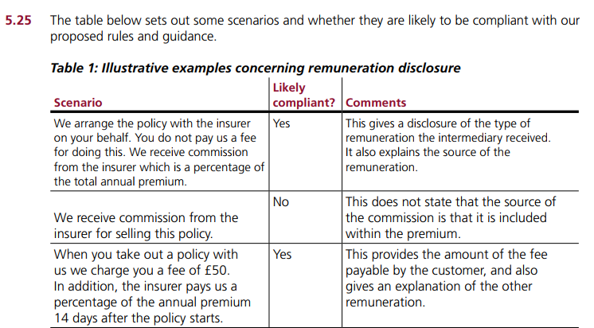
Notes:
There are a number of ways you can do this. For instance in your terms of business you can say “Insurers pay us a commission which is a percentage of your premium and in addition we charge a policy set up fee of £30 and mid term adjustment fee of £25. We also charge £25 if you cancel your policy.

Slide 15
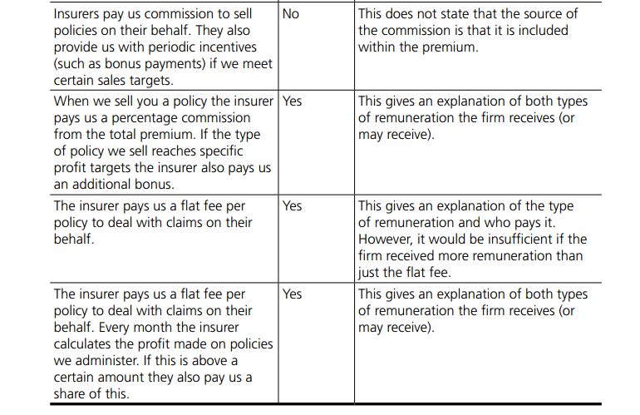

Slide 16
Insurance Distribution Directive
Changes to disclosure – Terms of Business and scripts for Commercial AND Consumer Customers
You must disclose whether you are acting for the Insurer or for the Customer
You must disclose whether you are a Broker or an Insurer
In both cases you must act in the customers’ best interest

Slide 17
Insurance Distribution Directive
Changes to disclosure – Terms of Business and scripts for Commercial AND Consumer Customers
You must disclose whether or not you provide advice or just information
Insurers must disclose if staff have sales incentive schemes
Notes:
IPID
Disclosure of where commission comes from and whether sales staff receive bonuses
Conflicts of interest – whether acting for insurer or customer
Must always act in the best interests of the customer
Disclosure of whether advice or advice on a fair and personal recommendation – or no advice
Record keeping
“Good repute” may mean criminal record checks for all staff
Cross selling – where 2 products sold together and one is not insurance, one must be optional
Requirement to act always in the best interest of the customer and will include wholesalers who conclude contracts
Product governance rules including value for money and appropriate training for distributors
15 hours CPD
Marketing material must be identified as such
Changes on rules on introducers
Disclosure of names of all insurers where advice is not on a fair and personal analysis of the market
PERG 5.16.2. says The MERE provision of data and information on potential policyholders to insurance intermediaries, reinsurance intermediaries, insurance undertakings or reinsurance undertakings where the provider does not take any additional steps to assist in the conclusion of an insurance or reinsurance contract; does not constitute insurance distribution. The FCA say (PERG 5.6.4C) it covers those situations where a person provides EXISTING information they hold on potential policyholders ( for example their name and contact details) but does not extend to information they obtain from other means such as pre-purchase questioning. Can a broker get rid of its IARS? Each case is ;likely to be different. The easiest case is if an existing organisation had a membership list, it could pass it to a broker and receive payment without being an IAR. ( GDPR however means they would need specific informed consent and all that entails.

Slide 18
Insurance Distribution Directive
Additional requirements
The Customer must be given a clear choice to receive all documents on paper (and free of charge) or by electronic means (email, PDF etc.)
Notes:
Check this out with mike as we are still waiting for clarity from FCA on this

Slide 19
Insurance Distribution Directive
Changes applying to Staff
Al firms must maintain records to demonstrate that those directly involved in Insurance Distribution or its Management:
Have no serious Criminal Convictions relating to property or financial crimes
Are not undischarged Bankrupts
One Senior Member of Staff must take responsibility for maintaining these records (are they going to undertake searches?)
Notes:
The rules on Criminal and Financial record keeping requirement this will be in SYSC 28 ( when it exists)
Disclosure of where commission comes from and whether sales staff receive bonuses
Conflicts of interest – whether acting for insurer or customer
Must always act in the best interests of the customer
Disclosure of whether advice or advice on a fair and personal recommendation – or no advice
Record keeping
“Good repute” may mean criminal record checks for all staff
Cross selling – where 2 products sold together and one is not insurance, one must be optional
Requirement to act always in the best interest of the customer and will include wholesalers who conclude contracts
Product governance rules including value for money and appropriate training for distributors
15 hours CPD
Marketing material must be identified as such
Changes on rules on introducers
Disclosure of names of all insurers where advice is not on a fair and personal analysis of the market
PERG 5.16.2. says The MERE provision of data and information on potential policyholders to insurance intermediaries, reinsurance intermediaries, insurance undertakings or reinsurance undertakings where the provider does not take any additional steps to assist in the conclusion of an insurance or reinsurance contract; does not constitute insurance distribution. The FCA say (PERG 5.6.4C) it covers those situations where a person provides EXISTING information they hold on potential policyholders ( for example their name and contact details) but does not extend to information they obtain from other means such as pre-purchase questioning. Can a broker get rid of its IARS? Each case is ;likely to be different. The easiest case is if an existing organisation had a membership list, it could pass it to a broker and receive payment without being an IAR. ( GDPR however means they would need specific informed consent and all that entails.

Slide 20
Insurance Distribution Directive
Changes applying to Staff
All Insurance Staff must be of good repute (see previous slide)
All Insurance Staff will need 15 hours of CPD, covering specified areas of training and knowledge
The 15 hours is a bare minimum and should of course be exceeded if a firm wishes to be professional
Records must be kept for 3 years
Employees are entitled to a copy

Slide 21
Insurance Distribution Directive
Changes applying to Staff
This will require employees to have a minimum necessary knowledge of:
Terms and conditions of policies offered
Applicable laws governing the distribution of insurance products
Claims handling (note claims handlers must be trained on the product not just handling procedures)
Complaints handling

Slide 22
Insurance Distribution Directive
Changes applying to Staff
And also:
Assessing customer needs
The Insurance Market
Business Ethics (like unacceptable business practices)
Financial Competence (can you explain percentages can you explain has the parts of the premium fit together)
Whilst there is no specific reference to testing the FCA T&C requirements state you must test and define competence

Slide 23
Insurance Distribution Directive
Conflicts of Interest
Firms must have a written Conflicts of Interest Policy which contains:
Identification of conflicts from remuneration or other sources
Identification of conflicts from other parties (like brokers receiving hospitality from insurers), related companies or members of the same group (a broker using their own MGA)
Notes:
The rules on Criminal and Financial record keeping requirement this will be in SYSC 28 ( when it exists)
Disclosure of where commission comes from and whether sales staff receive bonuses
Conflicts of interest – whether acting for insurer or customer
Must always act in the best interests of the customer
Disclosure of whether advice or advice on a fair and personal recommendation – or no advice
Record keeping
“Good repute” may mean criminal record checks for all staff
Cross selling – where 2 products sold together and one is not insurance, one must be optional
Requirement to act always in the best interest of the customer and will include wholesalers who conclude contracts
Product governance rules including value for money and appropriate training for distributors
15 hours CPD
Marketing material must be identified as such
Changes on rules on introducers
Disclosure of names of all insurers where advice is not on a fair and personal analysis of the market
PERG 5.16.2. says The MERE provision of data and information on potential policyholders to insurance intermediaries, reinsurance intermediaries, insurance undertakings or reinsurance undertakings where the provider does not take any additional steps to assist in the conclusion of an insurance or reinsurance contract; does not constitute insurance distribution. The FCA say (PERG 5.6.4C) it covers those situations where a person provides EXISTING information they hold on potential policyholders ( for example their name and contact details) but does not extend to information they obtain from other means such as pre-purchase questioning. Can a broker get rid of its IARS? Each case is ;likely to be different. The easiest case is if an existing organisation had a membership list, it could pass it to a broker and receive payment without being an IAR. ( GDPR however means they would need specific informed consent and all that entails.

Slide 24
Insurance Distribution Directive
Conflicts of Interest
Firms must have a written Conflicts of Interest Policy which contains:
Details of procedures to be followed in the event of a COI
A gifts and benefits policy setting out the circumstances that gifts can be offered or accepted
There must also be an annual report to the board

Slide 25
Insurance Distribution Directive
Customers’ Best Interests
Obligation on Member States to ensure that, when carrying out distribution, Insurance Intermediaries, Insurance and Reinsurance undertakings always act honestly, fairly and professionally in accordance with the best interests of their Customers (consumer or commercial)
Notes:
You might think this is already the case, but it isn’t. It is a wide ranging directive underpinned by the principle that the customer
(whether commercial or consumer

Slide 26
Insurance Distribution Directive
Customers’ Best Interests
Rules ensuring that brokers, and insurers do not either pay or assess the performance of employees in a way that conflicts with their duty to act in the best interests of customers

Slide 27
Insurance Distribution Directive
Product Information
The new requirements require the Customer to be given a standardised insurance product information document (IPID), summarising the main features of the proposed contract
The responsibility is on the Insurer or product designer(s) to produce this document

Slide 28
Insurance Distribution Directive
Product Information
The IPID is a template document
There are very strict rules about how it is presented, which can be followed ( fonts, logos etc)

Slide 29
Insurance Distribution Directive
Product Information
The IPID is only required where the Customer is a Consumer
The same product information still needs to be given to Commercial Customers, but there is no requirement to do so in the format of an IPID
It may be more convenient to use an IPID for some Commercial risks

Slide 30
Insurance Distribution Directive
Product Information
Currently a Policy Summary is used for most Insurance Products to provide this information, so in effect, this will be replaced by the IPID
Pure Protection Products will still require a Policy Summary (and no IPID)

Slide 31
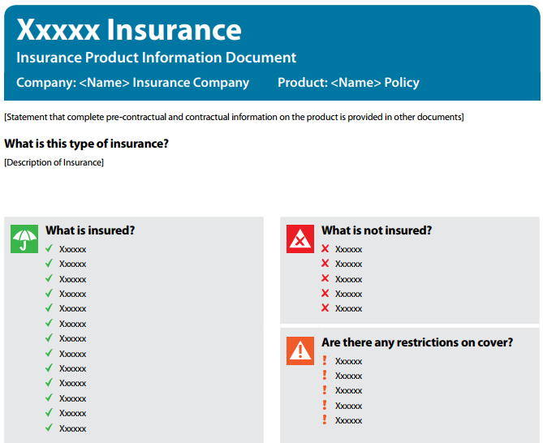

Slide 32
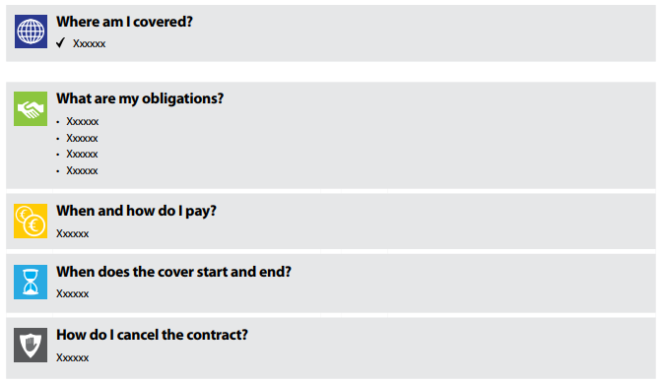

Slide 33
Insurance Distribution Directive
Complaints
Firms should have complaints procedures for all customers (not just eligible complainants)

Slide 34
Insurance Distribution Directive
Product Oversight and Governance
New rules covering the design, approval, marketing and management of Insurance products including:
Setting up and maintaining a product approval process so that new products are tested before launch
Ensuring that a target market is identified
The distribution (Intermediary) channels are selected appropriately (e.g. it may be certain complex products should only be sold via a broker not online)
These rules include redesign

Slide 35
Insurance Distribution Directive
Product Oversight and Governance
Staff involved in producing new products must demonstrate that they have the necessary expertise for this role
New products (policies) come with appropriate information and details of how they were approved
There must be ongoing Management Information on product performance including for example claims ratio’s

Slide 36
Insurance Distribution Directive
Product Oversight and Governance
Intermediaries (if used in the sales process) must have sufficient information about the product, the approval process, and who the product is suitable for
In some cases (for example where an Intermediary negotiates features to be included in a policy), they will share some of the governance responsibility as if they were the Insurer

Slide 37
Insurance Distribution Directive
Sales Practices
There are new requirements when Insurance is sold alongside a non-Insurance Product
There are two circumstances to consider:
Where Insurance is the main Product, or
Where a Non-Insurance Product is the main Product

Slide 38
Insurance Distribution Directive
Sales Practices
Where Insurance is the main Product:
The Customer must know if the Non-Insurance product(s) can be bought separately
A description of the Non-Insurance Product(s) must be given, including any interactions with the Insurance Product
Information on the costs and charges of the Non-Insurance Product(s) must be explained
Examples: Telematics, Fitness Devices

Slide 39
Insurance Distribution Directive
Sales Practices
Where a Non-Insurance Product is the main Product:
The Customer must be able to purchase the primary product or service without the Insurance product (if it is given free the customer can technically refuse the insurance but there would be little point!)
Examples: Insurance with a Car or Mobile Phone

Slide 40
Insurance Distribution Directive
Introducer Appointed Representatives
Introducing is exempt from regulation if all the Introducer does is pass on information to a Broker, where that information is already held on the introducers own records (for example customers Name & Address)
This area is complex, and you may need advice

Slide 41
Recap …
Understand the background and why IDD is being implemented and when?
Who is applies to?
Describe what the changes are
Explain what the impact is on general insurance firms, the impact on customers
Describe what firms should be doing in preparation for the changes

Slide 43
Create Solutions Ltd
The specialist training and compliance company for the general insurance industry
Tel 0161 870 6637
www.createsolutions.co.uk

