Slide 1
A Changing World: Risk Management, Planning and Response in a Post Covid World
Stuart Robertshaw ACII, Tech IOSH
Chartered Insurance Risk Manager
Robertshaw Technical
Insurance Services
Dewsbury
Notes:
On completion of the course, those attending will be able to:
Write a safety policy
Identify the main sources of guidance and information
Understand the main steps involved in risk assessment
Know the basic requirements for fire safety, welfare, first aid and employers liability cover

Slide 2
Learning Objectives
Areas to consider when opening up after lockdown 2 or local lockdown
How to deal with a COVID-19 outbreak
Procedures for bringing staff back to work particularly vulnerable staff
Planning for the future
Notes:
Getting hurt at work or becoming ill through work is not a pleasant subject to think about. The reality is that 250 people a year lose their lives at work in Britain. In addition, around 156 000 non-fatal injuries are reported each year, and an estimated 2.3 million suffer from ill health caused or made worse by work.
The mistake is to believe that these things happen in highly unusual or exceptional circumstances that never occur in your workplace. This is not the case. Some basic thinking and acting beforehand could usually have prevented these things from happening.
Implementing health and safety measures doesn’t have to be expensive, time consuming or complicated, in fact, safer and more efficient working practices can often save money but, more importantly, they can help to save lives.
This booklet shows you the kind of things which cause the more common accidents and harm to people’s health. It lets you see what applies to your work activities, and tells you how you can get more help and information.
This is especially important if you are in charge of work activities,
E.g. you are an employer, because you have legal responsibilities.

Slide 3
Risk Management
Health & Safety
Fire Safety
Security
Business Continuity
Cyber
Notes:
Controlling dangers at work is no different from tackling any other task – recognising the problem, knowing enough about it, deciding what to do, putting the solution into practice.
If you have five or more employees you will need to have a written health and safety policy statement. This sets out how you manage health and safety in your organisation. On pages
There is an example of a health and safety policy statement that you can fill in and keep at your workplace (but you do not have to use this format).
Remember, you have to put what you write into practice.
You must also carry out risk assessments – These are careful examinations of what could cause harm to people in your work. You can use one of RTIS forms to record your risk assessment, if you wish to (but you do not have to use this format).

Slide 4
Todays Webinar
Today we will only be considering Covid-19 and how to manage it within the workplace
Otherwise we’ll be here all week!
Notes:
Did you know employers have to consult their employees or their employees’ safety representatives on health and safety matters?
Did you know employers have to provide health and safety training for employees?

Slide 5
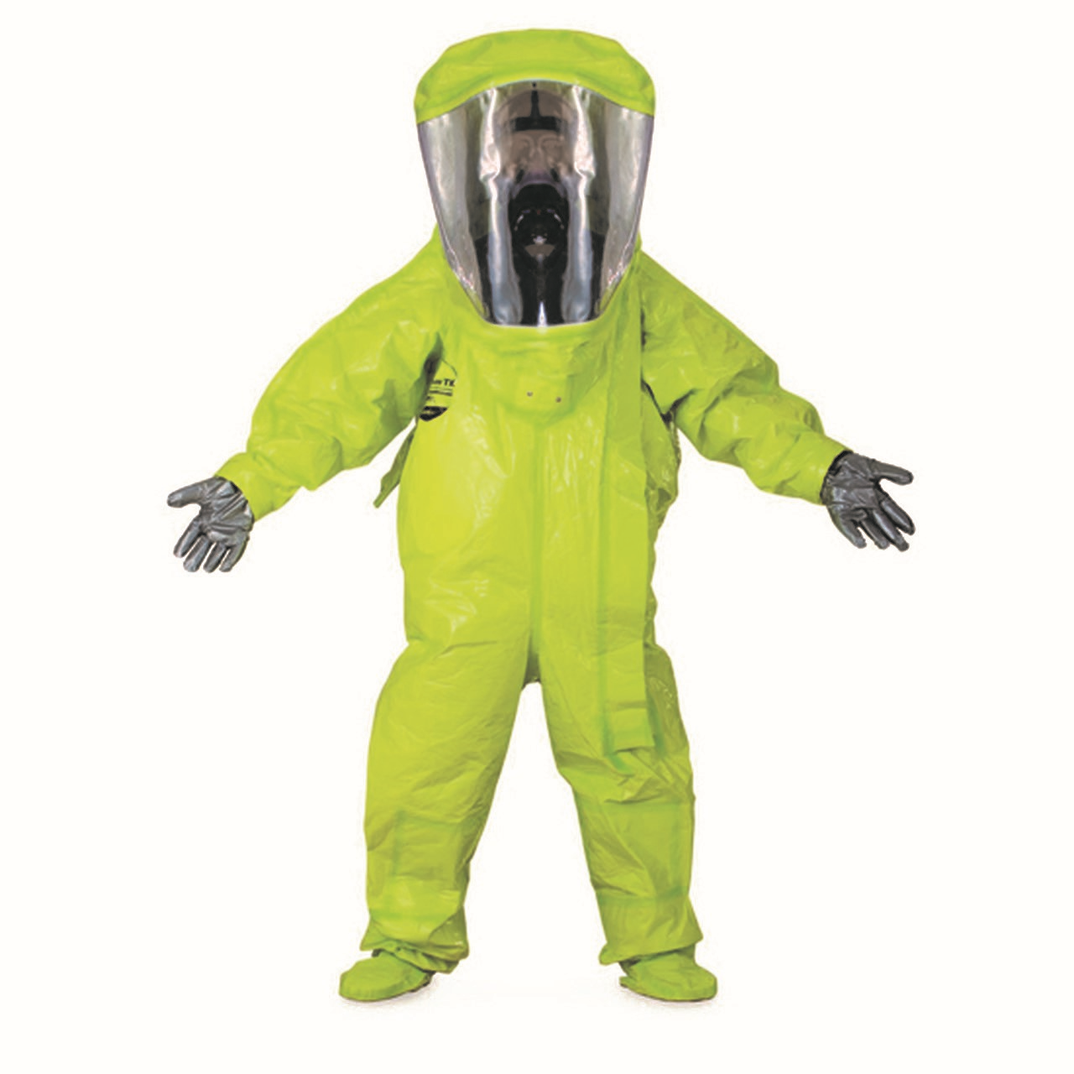

Slide 6
WHAT LAW APPLIES?
Management of Health and Safety at Work Regulations 1999 (risk assessment)
Health and Safety (Consultation with Employees) Regulations 1996
Covid-19 Guidance Documents

Slide 7
History!
Rewind to Christmas Day 2019 – who had heard of Coronavirus or Covid-19?
Fast forward 3 months and “the bad cold” resulted in a national lockdown, part of a worldwide response to the worst virus in a century!
Offices, factories, shops, pubs and clubs fell silent, massive queues outside supermarkets and a world shortage of pasta and toilet rolls!
Reopening of shops and offices started in June and July after over 3 months of lockdown.
Notes:
The most common cause of injuries at work is the slip or trip. Resulting falls can be serious. They happen in all kinds of businesses, but sectors such as food and catering report higher than average numbers. It’s a particularly important subject if members of the public use your premises. The estimated cost to employers of all these injuries is over £300 million a year, and insurance only covers a small part of this. Effective solutions are often simple, cheap and lead to other benefits.

Slide 8
History!
Local lockdowns then followed as infection rates in certain areas started to rise – confusion followed!
Universities returned, infection rates in these areas soared
Tier system introduced on 14th October Tiers 1, 2 and 3 detailed Medium, High and Very High
Lockdown 2 introduced on 5th November – different from first lockdown in many activities including schools, colleges and Universities stay open – change in public attitude
Today/ 2nd December????
Notes:
The most common cause of injuries at work is the slip or trip. Resulting falls can be serious. They happen in all kinds of businesses, but sectors such as food and catering report higher than average numbers. It’s a particularly important subject if members of the public use your premises. The estimated cost to employers of all these injuries is over £300 million a year, and insurance only covers a small part of this. Effective solutions are often simple, cheap and lead to other benefits.

Slide 9
During Lockdown 1
People worked from home if possible
Many workers furloughed
We discovered Zoom!
BUT!
Speedily assembled work areas at home – suitable?
Mental Health
Connectivity
Human interaction

Slide 10
As Lockdown 1 Ended
Rush to reopen particularly shops
Workers nervous about returning
Pubs and restaurants
Shortage of raw materials in manufacturing
Price of PPE, hand sanitiser and gloves rocketed and became in short supply
They think its all over!... Seaside trips!
Notes:
Asbestos is the largest single cause of work related fatal disease and ill health in Great Britain. Almost all asbestos-related deaths and ill health are from exposures several decades ago, but if you work with asbestos, or come into contact with it during repair and maintenance work, you are at risk. You should avoid working with asbestos if possible, but if not you must do it safely.
Asbestos can be found in buildings built from 1950 to 1985 in many forms. It may also be found in some vehicle brake pads and clutch linings.

Slide 11
Issues on reopening - Premises
Water Systems – legionella
Air conditioning systems – legionella and Covid
Lifts – statutory inspection
Plant such as compressors and forklift trucks – statutory inspections
Fire extinguishers – serviced?
Vermin
Waste – items left or forgotten on lockdown
Alarms and emergency lights – tested/ working
Notes:
Do you know whether there is asbestos in your premises? It is often found in roofs and exterior walls, boilers, vessels and pipework, ceilings, interior walls and panels, flooring materials, air handling systems, domestic appliances, brake/clutch linings, fire blankets, etc. Does your work involve maintenance and repair of premises? You might disturb asbestos while doing routine work. Do you know what the rules are about removing asbestos? In most cases, you will need to use a contractor licensed by HSE to work with asbestos.
Would you know how to find someone licensed to do this work? Do you know whether there is asbestos in any of the materials you work with?

Slide 12
Issues on reopening – Premises continued
Electrical safety – particularly if answer to vermin was yes
Gas safety
Carparks and grounds – who’s used them during closure and for what!
Layout of workplace – one way systems, passing areas, width of corridors, pinch points
PPE and items required – masks, screens around desks, spacing, hand sanitiser, antibacterial wipes, cleaning regimes
Fire Safety

Slide 13
Issues on reopening – Premises continued
Signage – language, guidance for hand washing, reminders what to do, reminders of symptoms
Removing as far as possible frequently touched items that are unnecessary – clocking in machines, keeping doors open where possible, windows open for ventilation - but drafts!
Vehicles – have they been parked up for the period – check tyres, brakes, levels, vandalism/ theft damage if left on premises.
Supply items to vehicles for sanitising after each driver if multiple users
Notes:
Thousands of people are exposed to all kinds of hazardous substances at work. These can include chemicals that people make or work with directly, and also dust, fume and bacteria which can be present in the workplace. Exposure can happen by
breathing them in,
contact with the skin,
splashing them into the eyes or swallowing them.
If exposure is not prevented or properly controlled, it can cause serious illness, including cancer, asthma and dermatitis, and sometimes even death.
See also section on ‘Fire and explosion’ and the ‘safe handling and use of substances’ section.

Slide 14
Issues on reopening - People
Covid-19 questionnaires – know who is coming back and what potential problems they could bring
Who’s vulnerable?
Underlying medical conditions – who do they live with – who do they look after?
How do people get to work – public transport, car sharing.
Anyone had Covid-19 whilst off? Current condition? “Long Covid”

Slide 15
Local Rules
Some areas were in local lockdown before the national lockdown 2 with varying restrictions where a rise in cases was causing concern.
If travel abroad to a country with infection rate of more than 20 per 100,000 then individual would have to self isolate for 14 days on return to this country
UK infection rates…………..
What happens on 2nd December…….

Slide 16
Local lockdown continued
Per 100,000 on 16th September –
Leeds - 73
Bradford - 74
Hull – 17
Per 100,000 on 9th November
Leeds – 445.2
Bradford – 566.5
Hull – 770
Anyone fancy a day trip to Hull??
Notes:
Falls from a height account for around 70 fatalities and 4000 major injuries every year. One of the main causes is falls from ladders. To help prevent falls from height you should consider the risks to all your workers, ensure they are trained and have suitable and safe equipment for the tasks, are properly managed and supervised. You should also ensure that sufficient protection measures (eg suitable and sufficient personal protective equipment) are in place while they are working at height.

Slide 17
Local lockdown continued
To give some idea of how the rates are increasing, in my area of Kirklees –
4th September – active cases – 70
11th September – active cases – 230
14th September – active cases – 372
26th November – active cases – 5726
Up 1298 in a week!
This is repeated in many areas of England
Source Covid-19 Symptom Study App

Slide 18
Whats happening?
Non-compliance?
Lack of correct use of protections – masks worn incorrectly, however, wearing a mask does NOT stop you getting the virus – it stops you GIVING IT to someone – sense of false security!
Sticking to the Guidance – washing your hands, keep 2m apart, wear a face covering
You can thank me for this later – to the tune of the wheels on the bus…
Hands and face and give some space…..

Slide 19
Whats happening? continued
Whats it like when out shopping now? – 2m distance?
Parties/ Illegal Raves/ Ways around rules
No surprise the largest number of positive Covid tests is in 20 to 40 year olds.
Approx 50% of people asymptomatic
Most contagious 1 -2 days BEFORE symptoms
Clubs and leisure facilities were operating
Pubs, restaurants, worship premises, retail, gyms…….. Were all allowed to re-open – did the 10pm curfew work?? Street Parties! Open too much at same time?
Notes:
Manual handling is transporting or supporting loads by hand or using bodily force. Many people hurt their back, arms, hands or feet lifting everyday loads, not just when the load is too heavy. More than a third of all over-three-day injuries reported each year to HSE and to local authorities are the result of manual handling. These can result in those injured taking an average of 11 working days off each year. ‘Upper limbs’ refers to the neck, shoulders, arms, wrists, hands and fingers. Upper limb disorders (sometimes called repetitive strain injury (RSI)) can happen in almost any workplace where people do repetitive, or forceful manual activities in awkward postures, for prolonged periods of time. These can cause muscular aches and pains, which may initially be temporary, but if such work is not properly managed, and the early symptoms are not recognised and treated, can progress to a chronic and disabling disorder. Cumulative damage can build up over time causing pain and discomfort people’s backs, arms, hands and legs. Most cases can be avoided by providing suitable lifting equipment that is regularly maintained, together with relevant training on both manual handling and using the equipment safely (see page 13 ‘Work equipment and machinery’).
Untidy workplaces account for a number of slips, trips and falls which result in sprains, strains and broken bones. In addition, apart from creating a bad impression on customers/clients, untidiness causes inefficiencies in the business (a tidy workplace shows a tidy mind)

Slide 20
Covid-19 Risk Assessment
Premises can only open and operate if they are “Covid Secure” (unless on lockdown list)
This means they have to have carried out a Covid-19 Risk Assessment which is suitable and sufficient
HSE are actively carrying out inspections only looking at Covid measures – as a minimum this is the document they want to see and it must pass the suitable and sufficient test to be accepted.

Slide 21
Covid-19 Risk Assessment continued
What should it contain?
Reference to having checked for clinically vulnerable people – employees/ customers/ family – Covid Questionnaire
How do employees get to work?
Procedures and controls – partitions, one way systems, sanitisation and cleaning procedures and evidence
Social distancing – 2m unless other controls in place

Slide 22
Covid-19 Risk Assessment continued
Masks/ face shields/ gloves – training
Antibacterial wipes, gels or sprays around the workplace
Canteen areas – staggered break times
Hand washing facilities
Signage
Procedures
Staggered arrival/ leaving/ shift times
Workpace department/ shift bubbles
Notes:
Using a computer or other kinds of display screen equipment (visual display units) can give rise to back problems, repetitive strain injury, or other musculoskeletal disorders. These health problems may become serious if no action is taken. They can be caused by poor design of workstations (and associated equipment such as chairs), insufficient space, lack of training or not taking breaks from display screen work. Work with a screen does not cause eye damage, but many users experience temporary eye strain or stress. This can lead to reduced work efficiency or taking time off work.

Slide 23
What if someone develops symptoms or tests positive?
Everyone should know the symptoms – make sure all staff do! If they get a symptom they must not come in to work
They must self isolate and arrange a test – negative doesn’t mean they don’t have it!
They must tell their employer of this
Acting fast is vital to containing any possible outbreak – this is where the procedures in place and the planning beforehand is worth its weight in gold!

Slide 24
What if someone develops symptoms or tests positive?
Identify who the person has had close contact with in the previous 48 hours, within 2m for at least 15 minutes, or 1m if masks worn or screens, if unsure on time and distance treat as if they have!
Send them home and instruct to self isolate for 14 days or until the person thought to have Covid-19 has had test results back.
NHS Test & Trace App? Lockers roaming!

Slide 25
What if someone develops symptoms or tests positive?
Sanitise the area, antibacterial wipes or a bleach solution, fogging?
Leave for 72 hours if possible
When the individual gets tested, if it is positive they must stay at home for 10 days or until temperature returns to normal and self isolate
If anyone else develops symptoms they must get a test – if positive the 10 days starts from the date of the test – follow the NHS Test and Trace advice
Notes:
High levels of noise at work can cause hearing loss. This can take many years to become serious.
Young people can be damaged as easily as the old and premature deafness is even worse. Sufferers often first start to notice hearing loss when they cannot keep up with conversations in a group, or when the rest of their family complains they have the television on too loud. Deafness can make people feel isolated from their family, friends and colleagues.

Slide 26
What if someone develops symptoms or tests positive?
The Government has produced a number of sector specific Action Cards with action to do lists on them, get one and fill in the telephone number of PHE who looks after your area.
If more than one individual has Covid-19 ring the number, the sooner PHE are involved the better support that is given or available.
Acting fast – within hours not days is vital – be ready
Initially PHE and the local EHO will be involved – they will want to know what steps you’ve taken and have you identified and segregated those involved – they will inform HSE who will visit

Slide 27
Case Study
Manufacturer gets a phone call at 9am on Monday morning, advising employee tested positive at the weekend.
By 930am, with our involvement, area the person worked in was identified and 5 employees in same area sent home told to self isolate as a precaution.
Area segregated and cordoned off, left for 72 hours
Wednesday morning one of sent home employees confirms they tested positive

Slide 28
Case Study continued
Wednesday lunchtime EHO acting on behalf of PHE arrives on site, Test and Trace identified an outbreak. Wednesday afternoon HSE arrives on site to look at controls.
Thursday morning a number of staff don’t arrive for work advising they feel exposed/ worried.
Covid-19 Risk Assessment in place, HSE happy with measures and EHO/PHE confirm happy with how the outbreak is being managed, no further attendance on site
Notes:
Vibration from work with powered hand-held tools, equipment or processes can damage the hands and arms of users causing ‘hand-arm vibration syndrome’. This is a painful, irreversible condition which includes ‘vibration white finger’ and the effects can be impaired blood circulation, damage to the nerves and muscles, and loss of ability to grip properly. Back damage can be caused by vibration from a vehicle or machine passing through the seat into the driver’s body through the buttocks – known as whole-body vibration. Whole-body vibration can also be caused by standing on the platform of a vehicle or machine, so vibration passes into the operator through their feet.

Slide 29
Case Study continued
Letter sent to all staff reassuring them as to the control measures in place – PHE/ EHO/ HSE sent a copy. They confirm happy with situation.
Over the next 4 days remainder of staff sent home test positive – PHE/ EHO confirm still happy with measures – no other staff in other areas advise of symptoms and all staff temperature tested every morning.
Daily calls between PHE, EHO and HSE enable business to remain open due to control measures and management of situation

Slide 30
Case Study continued
Friday morning, courier contacts client advising they had heard about “major” outbreak and refusing to pick up collections – contact made, correct facts given and copy of the Risk Assessment supplied – courier reinstates collections within the hour.
In view of Chinese whispers decision made between PHE/ EHO and company to issue a Press Release, issued Monday morning
Press turn up on site Monday afternoon

Slide 31
Case Study continued
Story run on local news on television and appears in local press, all reassured due to PHE/ EHO statement – site remains open, no further positive tests or staff with symptoms
Whilst all this was going on toolbox talks given to staff to reassure and guidance given to reinforce control measures.
Multiple testing offered – catch 22!
14 days after first positive and PHE/ EHO close file, outbreak contained and over, site open throughout.
Notes:
Electricity can kill. Most deaths are caused by contact with overhead or underground power cables. Even non-fatal shocks can cause severe and permanent injury. Shocks from faulty equipment may lead to falls from ladders, scaffolds or other work platforms. Those using electricity may not be the only ones at risk. Poor electrical installations and faulty electrical appliances can lead to fires which can also result in death or injury to others.

Slide 32
Outcome
Consultant exhausted!!!!
Prompt
Confident and open, particularly with press
Adequate controls – suitable and sufficient Risk Assessment and everyone knew the action plan
Good communication with all stakeholders – PHE, EHO, HSE and staff.
3 other local companies in the area that had outbreaks in the same industry were forced to close for 14 days.

Slide 33
Cause of outbreak
Very early on in the outbreak it was identified that the employees involved not only worked in same area but shared 2 cars into work, car sharing was the most likely cause of the outbreak as all other control measures on site were observed!

Slide 34
Summary
In an outbreak:
Enforcing authorities will be involved – PHE, EHO, HSE
Press may take an interest
This can be overwhelming for staff, Managers and Directors who may have had little contact with official authorities/ press before.
To coin a phrase stay calm get support and follow your procedures – most importantly ensure a suitable and sufficient Risk Assessment is in place drawn up by a competent person
Notes:
Work equipment covers an enormous range spanning process machinery, machine tools, office machines, lifting equipment, hand tools, ladders and pressure washers. Important points include: selecting the right equipment for the job, making sure equipment is safe to use and keeping it safe through regular maintenance, inspection and, if appropriate, thorough examination, training employees to use equipment safely and following manufacturers’ or suppliers’ instructions. Accidents involving work equipment happen all the time – many serious, some fatal. See ‘safe plant and equipment’ section of the Health and Safety Policy Statement on page 25 of this leaflet.

Slide 35
The future
Increasing infection rates = further national lockdown and possible further increased local lockdowns after 2nd December/ Christmas – Tier 4??
Regional testing – Liverpool
Worst case result of Christmas easing?
Winter flu add to second spike
Keeping up to date with Guidance – a daily email currently with many changes
Will conferences, live events such as annual dinners ever return?
Impact of opening up again
Students returning home for Christmas
All could add to the spread

Slide 36
The future
Businesses need to be prepared for home working – systems, equipment - dual stations?
Support for staff, know who is comfortable working from home and who isn’t – mental health, support
Are large office spaces needed any more?
Staff must feel supported
New way of working – do you need to spend an hour in the car driving to see someone then an hour driving back? Zoom, Facetime etc

Slide 37
The future
Work life balance
More family time
Flexible working
Less risk commuting
21st century problems do I use Zoom, Facetime, Messenger Live, WhatsApp Live, Microsoft Teams………..
Notes:
It’s easy to overlook these activities because they happen now and again, and it’s often a contractor or service agency doing the work. Sometimes people are in places where no one normally goes, e.g. the roof or electrical switchboard. They may be fault finding, trying to repair something quickly often outside the routine. Not surprisingly there are many accidents. Falls from heights, e.g. ladders, are the most common cause of serious injury.

Slide 38
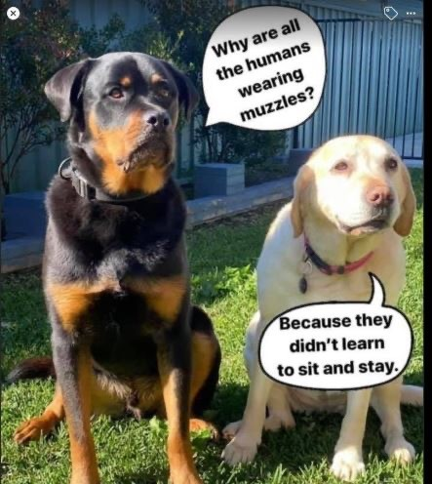

Slide 39
A Changing World: Risk Management, Planning and Response in a Post Covid World
THANK YOU ALL FOR YOUR TIME
ANY QUESTIONS??
And don’t forget
Hands and face and give some space……

