Slide 1
Time Management Essentials

Slide 2
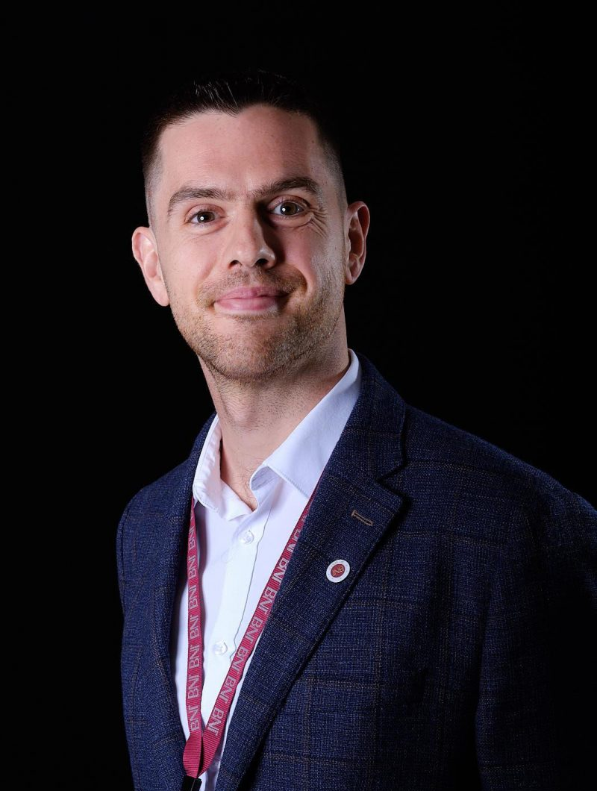
MICHAEL QUIGLEY FOUNDER OF KATAHOLOS
GROWING PEOPLE TO KNOW, TO DO AND TO BE THEIR BEST SELVES THROUGH A JOURNEY OF INTEGRITY, WHOLESOME RELATIONSHIPS AND LOVING KINDNESS.

Slide 3
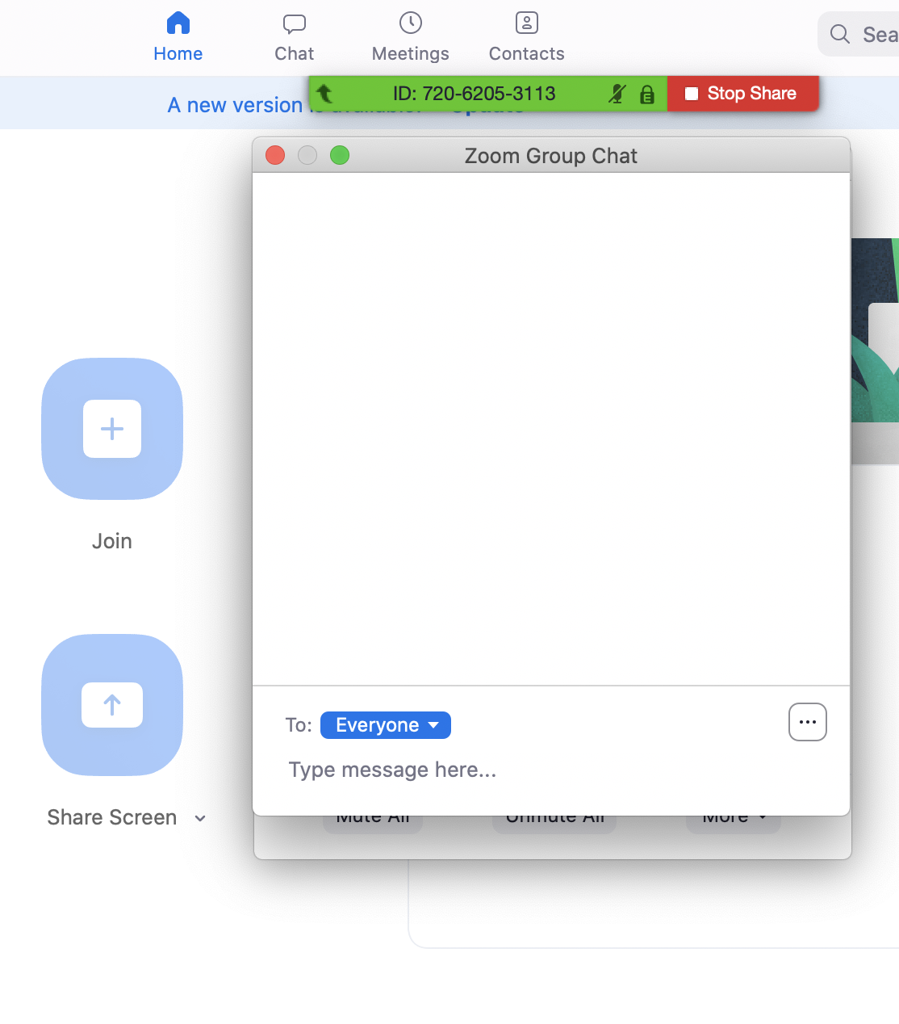
WATCH
USE THE CHAT BOX
MAKE NOTES

Slide 4
TODAY WILL GIVE YOU:
1. Information on time management
2. Thinking Tools for time management
3. A practical process for management

Slide 5
5 KEY LEARNING OBJECTIVES 1. Learn the highly effective Covey Time Matrix 2. Understand how to spend more time on what matters to you 3. Deepen your understanding of time and time effectiveness 4. Learn top tips to minimize wasted time, errors and increase productivity 5. Gain an understanding of the importance of relationships in time management

Slide 6
2 WAYS OF THINKING ABOUT TIME
1. CHRONOS- CHRONOLOGICAL OR SEQUENTIAL TIME
2. KAIROS- THE RIGHT MOMENT, THE OPPORTUNE MOMENT

Slide 7
5 KEY LEARNING OBJECTIVES 1. Learn the highly effective Covey Time Matrix Q1-4 2. Understand how to spend more time on what matters- Q2 3. Deepen your understanding of time and time effectiveness -Chronos and Kairos 4. Learn top tips to minimize wasted time, errors and increase productivity - get into Q2, ABC, Plan your time, use your time jar 5. Gain an understanding of the importance of relationships in time management - Q2, ABC

Slide 8
Your Take Aways 1. Your key take aways 2. Further learning 3. Application

Slide 9
CONTACT ME
LINKEDIN
+447581412253
WWW.KATAHOLOS.CO.UK
MICHAEL@KATAHOLOS.CO.UK

Slide 10
ANY QUESTIONS?

