Slide 1
CPD Lunchtime Meeting
Complaints Implementation of PS15/19
9th February 2016
Roger Binks
UK Complaints Manager, RSA
February 2016

Slide 2
Learning Objectives
By the end of this session you will………..
Have an understanding of the main complaint changes proposed by the Financial Conduct Authority (FCA) under PS15/19
Be able to identify key questions that you need to consider for your firm
Be able to identify a best practice model for implementation

Slide 3
Background To The Changes
Requirement | Deadline
1. Customers contacting a firm by phone (including mobiles) must not have to pay more than a “basic rate” | 26th Oct ‘15
2. Informal complaint resolution time extension from “close of play next business day” to end of 3 business days following receipt | 30th Jun‘16
3. Issue a Summary Resolution Communication (SRC) on all complaints resolved informally within 3 business days, making customers aware of their FOS rights | 30th Jun’16
4. * Report ALL complaints (including those resolved informally) to the FCA in the H2 2016 return | 1st Jul ‘16 * (prev 1st Jan ‘16)
5. * Changes to the biannual complaints return, to include more product information and a greater number of complaint categories | 1st Jul ‘16 * (prev 1st Jan ‘16)
6. * Contextualise complaint volumes by providing PIF information in biannual FCA reporting | 1st Jul ‘16 * (prev 1st Jan ‘16)
FCA Thematic Review
2013/2014
FCA Consultation
Dec 2014 to Feb 2015
FCA Policy Statement
Aug 2015
* FCA amended its requirements on 4th December 2015, allowing firms a further 6 months to implement these requirements

Slide 4

Basic Rate Call Charges – 26th Oct 2015
Customers contacting a firm by telephone regarding contracts already entered into with that firm, must not have to pay more than a “basic rate” (including mobile phone numbers)
For insurers, this includes calls from customers in relation to complaints, claims and other servicing queries
It brings financial services in line with provisions of the EU Consumer Rights Directive

Slide 5


Informal Complaints Time Extension – 30th June 2016
Extends the time for firms to resolve complaints informally from “close of next business day” to the end of 3 business days after receiving the complaint
Allows firms a longer time to handle complaints less formally, without sending a final response letter
“Close of business day” is the end of the ordinary business hours within which that firm operates
Caveat is that firms have to issue a written Summary Resolution Communication (SRC) giving FOS rights. The SRC can be letter, email or text

Slide 6
Changes to Complaints Reporting – 1st July 2016 onwards
ALL complaints to be reported to the FCA, including those resolved informally at the end of 3 business days in the 2H 2016 return
Changes to the biannual complaints return, will include more product information and a greater number of complaint categories
Reporting will contextualise complaint volumes by assessing complaint volumes per 1,000 policies in force (PIFs)

Slide 7
Key Questions to Consider
1. Applying the Complaints Definition
Throughout the Thematic Review and Consultation period, the industry lobbied the FCA to change the complaints definition, or to provide further guidance on materiality
FCA Complaint Definition
“Any oral or written expression of dissatisfaction, whether justified or not, from, or on behalf of, an eligible complainant about the provision of, or failure to provide, a financial service which alleges that the complainant has suffered (or may suffer) financial loss, material distress or material inconvenience”
Many firms simplify this to “any expression of dissatisfaction”
Most “non-material” complaints drop out in the informal process
Reporting ALL complaints irrespective of materiality could make firms look worse against industry peers. How will the public and Press react?

Slide 8
Key Questions to Consider
2. So how do you define Materiality?
Material Inconvenience | Our actions have had a direct impact on a customer’s life, causing a disproportionate amount of disruption or difficulty.
Financial Loss | Our actions have caused a customer to suffer a direct financial loss which can be quantified
Material Distress | Our actions have directly affected a customer’s emotional state. This may be stated or implied, and would include the following types of feelings...upset, embarrassment, anxiety, stress, suffering, sorrow, pain (this list is not exhaustive)

Slide 9
Key Questions to Consider
3. Responsibilities of Front Line Staff
What is the appetite within your firm to have your frontline staff making complaints decisions?
Are your frontline staff empowered to handle complaints, and to what extent?
Should your frontline staff be responsible for issuing the Summary Resolution Communication?
Will frontline staff handle complaints for the first 3 business days, or would you prefer them to escalate if they cannot resolve at first point of contact?
Do your frontline staff have the capacity to handle and accurately record ALL complaints?
How will you ensure they evidence to the regulator that the decisions are being made impartially and consistently?

Slide 10



Key Questions to Consider
4. The Summary Resolution Communication
How will you create and send the SRC? i.e. letter, email, text?
Will you tailor the information in the SRC to the individual complaint case?
Will you invite customers back in to mitigate referrals to FOS?
How will you ensure the customer is happy with the resolution?

Slide 11

Key Questions to Consider
5. Systems!
Do you use an in-house solution for capturing complaints or a software provider?
How will you ensure your systems capture the new reporting requirements?
Is this the right time to review your complaint system requirements?

Slide 12
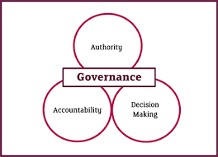
Key Questions to Consider
6. Do you outsource handling to Suppliers or DA’s
Complaints which are deemed to be material, relate to the firm’s regulated activity, and are from eligible complainants, will need to be reported. Even those where a resolution has been agreed within the informal deadline
Who will be responsible for reporting these complaints?
How will you ensure that you have appropriate oversight and governance over your outsourcing arrangement (FCA’s TR15/7 paper on delegated authority arrangements)

Slide 13
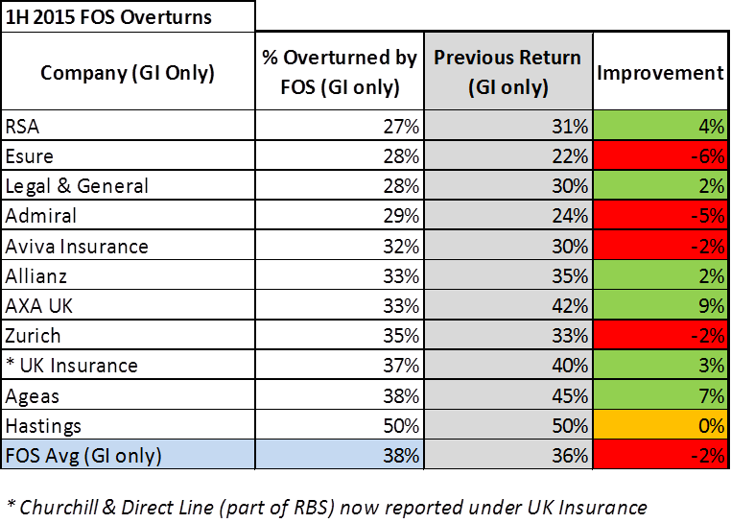
Key Questions to Consider
7. Reporting
How will your data look against industry peers when you report ALL complaints to the FCA?
Will you narrow reporting to only those complaints where you have provided a narrower assessment of materiality?
How easy is it to get your hands on data about how many Policies in Force you have at product level?
How will you incorporate complaints data for outsourced providers who are handling complaints on your behalf?

Slide 14
Best Practice Model
1. Framework to Success
Set up a dedicated Project Team and have appropriate Governance, ensuring decisions can be made quickly and supported by key stakeholders in your business
Define Work stream Leads (Process, People, Systems, External Partners, QA & Controls, Training & Comms)
Communication is Key – decide how you are going to engage with your business about the changes
Best operational fit – decide which Operating Model works for your firm
Best system requirement – can you adapt your systems to meet the requirements?
Training to all staff – face to face workshops, On-line assessments?
Evidencing QA and controls – ensuring oversight and accountability / empowerment
Effective Root Cause Analysis – taking ALL complaint learnings and FOS decisions into account

Slide 15
Best Practice Model
2. Project Structure
Project Steering Group
Project Sponsor
Complaints Lead
Project Manager
Compliance Lead
Work Streams
INTERNAL PROCESS
CONTROLS (QA)
EXTERNAL PROCESS
(DA / TP)
SYSTEM / MI
TRAINING & COMMS
CHANGE
TOM
REPORTING
SYSTEM CHANGE
Definition Refinement
Move to 3 day handling
Customer Comms Training Pack / Learning Zone Changes
Options Definition
Best practice research
Operating principles e.g. minimise hand off’s
HR eng’t for role changes
Quality Principles refined e.g. ensure that we can recognise and handle appropriately
Local owners identified
Best Practice research
Definition Refinement
Move to 3 day handling
Contract Changes
Comms Materials Changes
Roll Out
PIF Assessment
Reporting principles established
Process defined
Resource in place
First report run applied before BAU (Test Management)
Tool Decision made
IS eng’t applied for I/F changes
System Reqt’s refined
System Changes
Access Ctrl
Testing
Training Material for Roll Out
Training needs defined
Slots confirmed for roll out
Advocates defined and maintained
Comms applied (pre, during and post delivery)
Training Roll Out

Slide 16

Have the Learning Objectives been met?
At the end of this session you will………..
Have an understanding of the main complaint changes proposed by the Financial Conduct Authority (FCA) under PS15/19
Be able to identify key questions that you need to consider for your firm
Be able to identify a best practice model for implementation

Slide 17
Appendix - Key FCA Requirements & Industry Opinion
The FCA Expects firms to have…
Appropriate management controls in place to identify and rectify any recurring or systemic problems
An appropriate root cause analysis framework in place which involves the collation of data which informs senior personnel about the volume of complaints received, the reasons behind them, and any remedial activity required
Processes in place to allow the firm to investigate all complaints competently, diligently and impartially
Processes in place to allow a fair, consistent and prompt assessment of the complaint
Personnel with the authority and ability to determine whether or not the complaint should be upheld and if any remedial action or redress is appropriate
Personnel with a sound awareness of outcomes on similar complaints, and relevant FCA and FOS guidance and/or philosophies
Processes in place to allow for complaints to be resolved promptly, minimising the number of referrals to the FOS
The Industry Expert View of Complaints…
The majority of customers who have an issue do not complain – to reduce the number of non-complainants firms must have a transparent and simple complaint process
Effective RCA is a key principle to success and with senior management support. Compiling meaningful complaints MI is critical to enabling a firms management to make balanced and informed decisions to drive positive customer change
The vast majority of complainants changed their overall impression of the provider based upon their complaints experience
85% of customers expect firms to acknowledge their complaint within 48 hours and 82% of complainants resolved within 1 week
Complaint Ownership, Complaint Culture, Staff Capability and Communication are key components of good complaints best practice
Firms have more to do to define & monitor competence in their complaint teams
Timeliness plays a key role in many of the negative aspects experienced by customers
Notes:
FCA complaint Disp rules set out some important requirements and we have considered some of these important principles in our thinking
We have also worked closely with our industry peers and industry experts such as Huntswood and Grant Thornton
Key points to highlight are around controls to identify complaints, having a culture and capability of people who handle complaints and that they must be impartial, consistent in decision making and have sufficient authority to handle complaints
Customer research and industry experts tell us 82% of people expect their complaint to be resolved in less than a week so we have adopted a principle of getting the right complaint to the right person with the appropriate skills and knowledge

