Slide 1
Diversity and Equality
Paul Menham

Slide 2
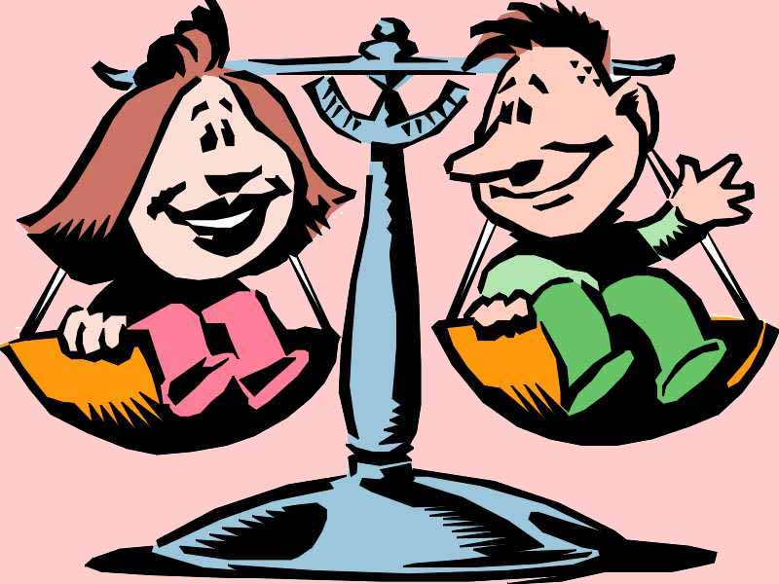
a
Agenda
Introduction and objectives
What is meant by Equality & Diversity?
What does the law require?
Understanding unlawful discrimination
Avoiding claims

Slide 3
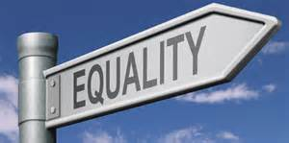
Training Objectives
Why attend?
There are an increasing number of allegations relating to Equality & Diversity
To ensure you have an understanding of why it is important to comply with the law
To provide a basic knowledge of the law that underpins these concepts
To avoid claims and minimise exposure

Slide 4
nd diverity?
What is Equality and Diversity?
Equality is a term used to denote equality of opportunity for all workers and employees so that they can:
work free from prejudice and discrimination
have the opportunity to fulfil their potential
have their own beliefs and values respected.
Diversity means “difference”. It is about valuing variety and the benefits of individual differences (not necessarily treating everyone “the same”)
The principles are underpinned by the anti-discrimination laws in the Equality Act 2010.

Slide 5
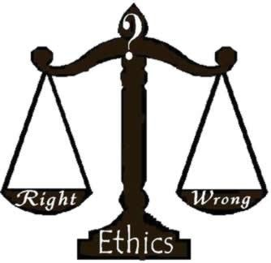
Why is it important?
The ethical case
The business case
A diverse workforce means a wider range of resources, skills and ideas providing a competitive edge
Discrimination record may be significant
Q: Can you think of other business reasons?
The risk of legal claims (with unlimited compensation)
Notes:
Discrimination may impact recruitment, terms and conditions of employment (or contract work), policy and procedure, day-to-day management decisions, termination of employment and standards of behaviour in the workplace.
Having a diverse workforce is important because the Company can offer a wider range of resources, skills, ideas and energy to the business, providing a competitive edge and attract, recruit and retain a wider talent pool.

Slide 6
Company Policy
What is your Policy?
Equality & Diversity Policy
Prohibits discrimination
Explains types of discrimination
Managers/Directors must set standards of behaviour
All breaches of the policy should be taken seriously and fully investigated
Breaches of the policy may be subject to disciplinary action up to and including dismissal (where appropriate)

Slide 7
What is discrimination?
Discrimination can occur on one of 9 unlawful grounds, known as “Protected Characteristics”
Sex
Sexual Orientation
Marital / Civil Partnership Status
Age
PROTECTED CHARACTERISTICS
Gender reassignment
Race
Disability
Religion or belief
Pregnancy and Maternity

Slide 8
Who is protected?
Cradle to grave…
JOB APPLICANTS
INTERVIEWEES
CONTRACTORS
AGENCY WORKERS
EMPLOYEES
EX EMPLOYEES

Slide 9
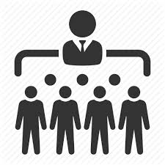
Who can be liable?
The Company Managers Other Employees

Slide 10
Who can be liable?
The Company – even if not aware of the discrimination
Individuals (managers, colleagues)
Any discriminatory conduct “in the course of employment”
Wide test
Can include work social events and client events

Slide 11
Tribunal Claims
Key points about discrimination claims..
NO CAP ON COMPENSATION
INTERNAL AND EXTERNAL PR ISSUES
NO SERVICE REQUIREMENT
AWARDS FOR INJURY TO FEELINGS, AGGRAVATED DAMAGES AND PERSONAL INJURY
MANAGEMENT TIME

Slide 12
Types of discrimination?
DIRECT
DISCRIMINATION
INDIRECT DISCRIMINAION
HARASSMENT
VICTIMISATION

Slide 13
Direct Discrimination
Less favourable treatment of one person than another person (whose circumstances are materially the same) because of a protected characteristic
NB – there may not be ‘proof’ that the treatment is due to a protected characteristic, inferences of discrimination can be drawn if an employer cannot give an adequate explanation for the treatment

Slide 14
Direct Discrimination
Example
Sue is 57 years old and applies for promotion. She is turned down.
The job is given to Mike who is 35 years old. Mike and Sue have the same experience, skills and qualifications.
Sue can claim age discrimination against the Company as she has been treated less favourably than Mike.
Her employer would need to be able to convince a tribunal that it had valid reasons for promoting Mike over Sue which were unrelated to age.
Q: Can you think of any other examples?

Slide 15
Be aware of Perception & Association
Perception
Perceived characteristic
e.g. straight male is a victim of homophobic banter
Association
Characteristic of close associate
e.g. less favourable treatment because of son’s disability

Slide 16
Indirect Discrimination
Indirect Discrimination
Indirect discrimination occurs when there is a working arrangement, policy or practice that applies equally to all but particularly disadvantages members of a protected group and a particular individual within that group
Example:
A full time female employee who has young children requests part time working hours. Her request is turned down. She brings a claim for indirect sex discrimination on the basis that she is disadvantaged by the requirement to work full time, as are the protected group (women who have childcare responsibilities).

Slide 17
Indirect Discrimination
Indirect discrimination can be justified (and so not unlawful) if:
there a legitimate business aim behind the arrangement; and
the arrangement is a proportionate means of meeting that aim
Example
The full time female employee who has young children has a role where she interacts with the public from 9.00-5.00pm. The role reasonably requires continuity from the same member of staff, and is therefore incapable of being carried out on a part time or job share basis.

Slide 18
Indirect Discrimination
Consider:
Is there a legitimate aim?
Does the policy achieve that aim?
Is there some other way you can achieve that aim without discriminating?
Balance it out
Needs of the business
Vs
Needs of the individual

Slide 19
ictimisation: examples
Victimisation
Victimisation is:
Treating a person less favourably than you would treat another because they have:
complained about discrimination;
been involved in a complaint about discrimination;
or intend to do either of the above.
Examples
refusal to provide a reference because they alleged discrimination
cold shouldering an employee who has brought a discrimination claim
Notes:
Any other examples?
Preventing victimisation
Maintain confidentiality of discrimination complaints.
Handle complaints professionally.
Review and document reasons for management decisions taken in relation to affected employees.
Train managers and staff about victimisation and include anti victimisation measures in published standards of behaviour (e.g. equal opportunities policy).

Slide 20
Discrimination: Quiz
Discrimination Quiz
Which of the following could be discrimination?
Requiring cleaning staff to be able to speak, read and write English fluently?
Not promoting a female employee because she is pregnant and will need to take maternity leave soon after she would start the new role.
Banning headgear for customer service advisors in a call centre?
Team socials are held at 6 pm on Friday evenings at the local pub.
A manager openly discussing an employee’s discrimination complaint with other members of staff?

Slide 21
harassment
Harassment
Harassment is:
Unwanted conduct related to a protected characteristic which has the purpose or effect of violating the victim’s dignity; or creating an intimidating, hostile, degrading, humiliating or offensive environment for the victim.
Example:
A woman has a total disregard for men in general. She refers to them as male chauvinist pigs, sometimes making snorting noises in their presence and saying things like “going home to your sty?” when a male is leaving work.
Notes:
In deciding whether conduct has the above effect the perception of the victim and whether it is reasonable for the conduct to have that effect will be taken into account.
Any other examples?
Is firm management harassment?
QUIZ
Preventing harassment
Set standards
Implement policy effectively
Address complaints
Enforce the disciplinary procedure

Slide 22
Harassment
Harassment can be:
verbal or physical abuse
jokes and banter
abusive or derogatory emails / texts
exclusion
gradual removal of responsibilities
Other examples?

Slide 23
harassment
Harassment
Key points about harassment:
No need for the victim to make it clear it is unwanted
A one-off incident can amount to harassment
‘Banter’ is not a defence
Harassment can be unintentional and the victims’ viewpoint must be taken into account (the test is whether it is reasonable for the conduct to have had that effect)
The conduct need not be directed at a particular employee for it to amount to harassment
Beware of assumptions and stereotyping
e.g. “Women are bad drivers”.
Notes:
In deciding whether conduct has the above effect the perception of the victim and whether it is reasonable for the conduct to have that effect will be taken into account.
Any other examples?
Is firm management harassment?
QUIZ
Preventing harassment
Set standards
Implement policy effectively
Address complaints
Enforce the disciplinary procedure

Slide 24
harassment
Harassment
Example
Male members of staff download pornographic images on to their computers in an office where a woman works. She may make a claim for harassment if she is aware that the images are being downloaded and the effect of this is to create a hostile and humiliating environment for her.
It is irrelevant that she doesn’t actually see the images, the male members of staff did not intend to upset the woman (and did not intend for her to know that they were being downloaded), and that they considered the downloading of images as "having a laugh".
Notes:
In deciding whether conduct has the above effect the perception of the victim and whether it is reasonable for the conduct to have that effect will be taken into account.
Any other examples?
Is firm management harassment?
QUIZ
Preventing harassment
Set standards
Implement policy effectively
Address complaints
Enforce the disciplinary procedure

Slide 25
Harassment: Quiz (1)
Harassment Quiz
True or False?
Harassment can be unintentional?
Behaviour is only harassment if a reasonable person would judge it to be so?
Harassment must be a series of two or more incidents?
The employer will not be liable for harassment if the employee has not complained about it before?

Slide 26
Harass
Harassment Quiz
True or False?
An employee can be personally liable for harassment of another?
The employer will not be liable for harassment by one employee of another if it did not know about the behaviour?
Harassment must be directed at the individual to be unlawful?

Slide 27
Disability Discrimination
Additional protection for disabled employees:
duty to make reasonable adjustments and
discrimination arising from disability
Not enough time today to go into any sort of detail. Be aware of definition of “disability”
TOP TIP: Consider all employees with long term health conditions as “disabled”
Notes:
Less favourable treatment because of a disabled person's disability.
Indirect disability discrimination.
Unfavourable treatment for a reason arising from a person's disability.
Failing to make reasonable adjustments to alleviate a substantial disadvantage to a disabled person.
Violating a disabled person's dignity or subjecting them to an intimidating, hostile, degrading, humiliating, or offensive environment because of their disability.
Less favourable treatment of a disabled person who has used, or threatened to use the protections afforded by the Equality Act.
QUIZ
Preventing harassment
Set standards
Implement policy effectively
Address complaints
Enforce the disciplinary procedure

Slide 28
Disability Discrimination
Definition of disability:
"A person (P) has a disability if P has a physical or mental impairment (at all), and the impairment has a substantial (more than minor) and long-term (12 months or more) adverse effect on his ability to carry out normal day-to-day activities".
Section 6(1) Equality Act 2010
Some conditions are deemed “disabilities” from day 1
Notes:
Less favourable treatment because of a disabled person's disability.
Indirect disability discrimination.
Unfavourable treatment for a reason arising from a person's disability.
Failing to make reasonable adjustments to alleviate a substantial disadvantage to a disabled person.
Violating a disabled person's dignity or subjecting them to an intimidating, hostile, degrading, humiliating, or offensive environment because of their disability.
Less favourable treatment of a disabled person who has used, or threatened to use the protections afforded by the Equality Act.
QUIZ
Preventing harassment
Set standards
Implement policy effectively
Address complaints
Enforce the disciplinary procedure

Slide 29
Avoiding Claims
Discrimination claims have uncapped compensation – usually loss of earnings plus an injury to feelings award (of up to £33,000)
No requirement for two years’ service to bring a claim
Huge amounts of management time
Significant legal costs
(Costs can be very reasonable with some providers)

Slide 30
Avoiding Claims
Have an Equality & Diversity Policy
Be familiar with and follow your Equality & Diversity Policy
Avoid making assumptions in your decision making
Train your staff (particularly managers) – a “statutory defence” to discrimination claims is possible if the workforce has been appropriately trained

Slide 31
Avoiding Claims
Deal with complaints fairly, openly and promptly
Take appropriate disciplinary action where behaviour is inappropriate
Act consistently in decision making and ensure you have a clear and full paper trail

Slide 32
Questions
Any Questions?

Slide 33
Legal Studio
For more information on our services or further advice regarding diversity and equality then please contact:
Web: www.legalstudio.co.uk
Email: pcm@legalstudio.co.uk
Tel: 0113 247 3802
Mobile: 07548 234 766

