Slide 1
Why now? Sunday Times Sept 2016

Slide 2
Why now? A steep learning curve?
‘ I NEED CYBER!’
© Many in our industry

Slide 3
Why now? TALK TALK £400,000 fine
Information Commissioner Elizabeth Denham commented -
Notes:
Addressing these points will hopefully reduce the occurrence of fraud by reducing the opportunities, in addition if employees are aware of the measures in place and there is a clear code of conduct that is communicated properly it will act as a deterrent.

Slide 4
Why now?
But it’s not only the household names at risk - 74% of UK businesses in 2015
University of Greenwich
MNH Platinum
Guernsey
Lincolnshire County Council
General Data Protection Regulation
New regulations in May 2018
Increases responsibility for data
Increases costs of a breach significantly
Notes:
Burning platform in the market
Lots of well-known names suffered attacks, from data breach to state-sponsoring hacking
Think of how you felt when your ebay/amazon passwords were compromised – reputation!
But not only large companies who are vulnerable
60% of small businesses suffered a cyber security breach in 2014
Impending legislation changing landscape for all businesses and increasing requirements

Slide 5
Utilise our CII resources!

Slide 6
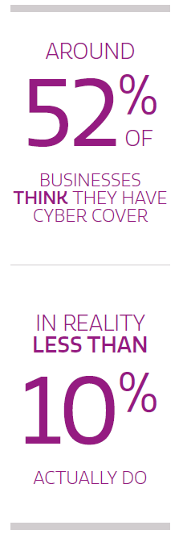
Everyone has a Cyber exposure
Notes:
you can't fight human nature - you can train people as well as you like but they can be tricked and they can be forgetful
Everyone has a cyber exposure.
Info Techn isn’t perfect – you need to build in the people factor.
40% of people move confidential work files to personal devices – I have sent docs home to work on and vice versa in the past.
Lots of passwords to remember – easier to write them down somewhere –
when the Financial Times was attacked, first thing infiltrators did was search for “password” in email files
There is an exposure, and 52% of businesses think they have cover for cyber risks. The truth is, less than 10% do.

Slide 7
Our clients have evolved
The coconut represents old style IT security;
Like a fortress this fruit is hard outside but soft inside
The mango represents the new cyber age approach to IT security.
Organisations that work towards the mango model and harden the core of their IT:
Understand their important data, like products, clients and contracts
Can identify their key processes like Research & development, sales tools etc.
Protect their critical applications; finance, HR
Can identify other vital infrastructures and systems
They have a business continuity or disaster recover plan that includes a Cyber Event.
They know which Cyber event will impact them the most.
Notes:
Mango’s are the type of business where we want sell a cyber policy

Slide 8
CYBER ISSUES – THE IMPACT TO YOUR CLIENTS AND THEIR CLIENTS ARE IMMEASURABLE

Slide 9
THE CLIENT HAS LOST SOME DATA
Notes:
Pick any of the recent examples. Talk Talk, Carphone Warehouse, Sony, Ashley Madison. In all these situations you’ll see the initial forensic cover – what has happened, what do we need to do to resolve the situation? Then we see PR expenses as the company try to manage the messaging. Added to this is the inevitable customer notification costs, albeit these in the main tend to be voluntary. It’s not just notifying the customer, many Insureds will also offer financial health check screening services or credit check monitoring to ensure the details have not been used to enter into loans or credit cards. There will be added costs in respect of data restoration. The final piece of the jigsaw being the potential BI loss.

Slide 10
RANSOMWARE – this is happening

Slide 11
OUR BOOKING SYSTEM HAS BEEN CORRUPTED
Notes:
The client ran a chain of hotels and restaurants. Their IT infrastructure and security surrounding their online booking site was ‘bullet proof’. Fraudsters sent an e-mail to a member of the accounts team headed ‘July Figures’. The Financial Controller opened this mail and also the attached spreadsheet. There was a virus that was released – the IT team at this client shut down their systems immediately. This included not only the internal mail and operations systems, but also the online booking site. They were unable to take bookings for 3 days whilst they worked through the issue. The main component of loss was the BI loss / loss of revenue to the client.

Slide 12
IN OUR MARKET
Cyber Liability is market news, but there is no market standard
While there is widespread acceptance that a vulnerability exists, there is often little understanding of what that vulnerability is
TWO WAYS TO LOOK AT CYBER
Cyber Risk can be split into two main sections:
Network Security Events
Privacy Related Events
Network Security Event
Negligent or inadvertent transmission of malware to a third party
Negligent failure to secure the network or computer system which results in unauthorised access
E.g.
Virus transmission
Hacker attack
Extortion
Data Liability Event
Loss or suspected loss of third party data for which the client is legally responsible
Breach of worldwide privacy legislation
E.g.
Lost laptop
Stolen storage device
Rogue employee
UNDERPINNED BY BUSINESS INTERRUPTION COVER

Slide 13
Cyber First Party Covers
What issues should you and your clients consider:
Forensics – what has happened – investigate
Legal Counselling and PR costs – do you need help – what are next steps
Voluntary notification costs
Data Restoration costs
Business Interruption
Notes:
What can your IT guy
Legal – Speacialist data lawyers – Not cheap – Who do you tell what you do you say?
How do you restore customer confidence (TALK TALK etc)
Voluntary – Until EU directive comes in it is volunetary to notify impacted data sunjects, But most customer sdavy customers do this.
BI – No fire! No flood! Talk T alk – Lost revenue 45-50Million

Slide 14
Cyber Third Party Covers
What issues should you and your clients consider:
Regulatory fines and penalties
Damages – claims from data subjects
Notification – mandatory notification costs
Legal Costs
EU GDPR May 2018 - this will ‘drive’ client interest

Slide 15
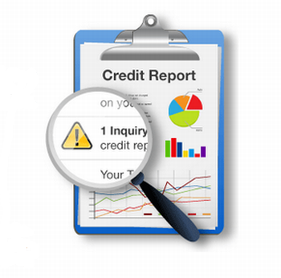
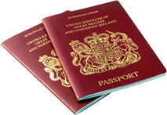
WHAT DOES A CLAIM LOOK LIKE?
Rescue
Cyber Extortion
PR Advice
Legal Advice & Defence Costs
IT Forensics
24/7 Helpline
Cyber Business Interruption
Credit & ID Monitoring Costs
Notification Costs
Response
Restoration
Data Restoration Costs
Notes:
Fundamental building block – 24/7 incident response helpline. Incident management led – our suppliers incident manage whole process rather than suggesting course of action and leaving you to it.
Step 1 is rescue – IT Forensics, Cyber Extortion
Every other product is legal driven so it incurs costs rather than responding to the issue. Ours is forensic driven – first call goes to forensics, first priority is to mitigate the impact by finding and closing down the problem ASAP.
Next part of Rescue is advice from PR and legal as appropriate
Step 2 is response – notify customers, cost of monitoring credit and ID
Step 3 is restoration – rebuilding data and getting access back, financial redress in shape of BI cover
Robust handpicked supply chain with pre-agreed rates
Experts across the board – on tap through incident project manager who handle it all for you

Slide 16
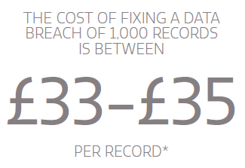
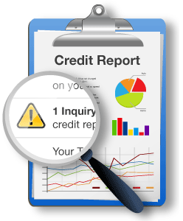
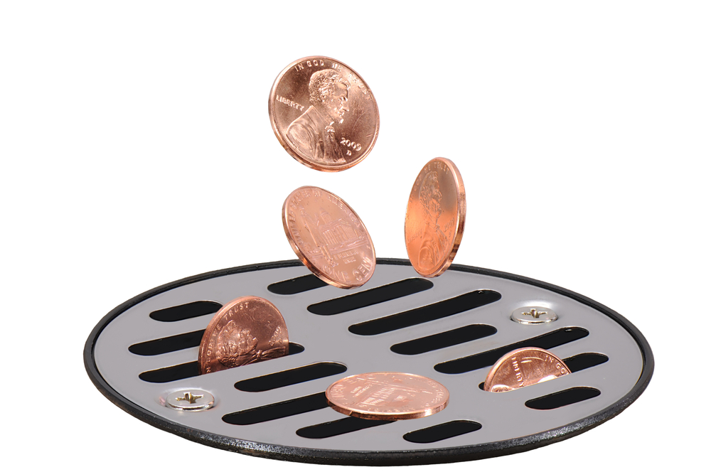
WHAT IS THE COST OF A CLAIM?
Do they even know what to do, who to call? Delay increases costs.
And that’s just the cost of looking after data breach victims
*Verizon Data Breach Investigations Report May 2015

Slide 17
CYBER THEFT COVERING YOUR CLIENTS OWN FINANCIAL LOSS

Slide 18
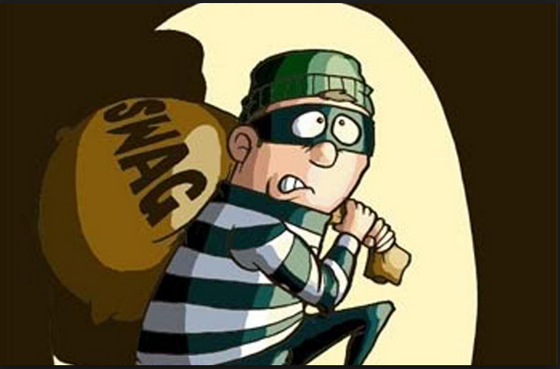
Then versus now……

Slide 19
Cyber Risks and Cyber Theft
Cyber Risks covers your client’s intangible risks associated with a Data Liability or Network Security issue – and any resultant exposure and costs
Cyber Theft already being covered under Commercial Crime products
Needs and demands critical what is your client concerned about? Sell the appropriate product
A Combined Cyber and Cyber Theft Policy is not a panacea to all ills. What about employee fraud, or fraud losses that do not have a Cyber mechanism as their proximate cause
The devil is in the detail – so let’s explore……..
IMAGERY AVAILABLE VIA BRAND CENTRE
Cyber Risks and Cyber Theft

Slide 20
Cyber threat

Slide 21
EMAIL CLOAKING? - CYBER OR COMMERCIAL CRIME?
Notes:
This fraud is interesting and worrying. A large UK multinational centralised their finance function. This finance team collated all payments to third parties. Part of their role was to collect payments from other divisions, which would then be settled. Hackers 'shadowed' a financial controllers e-mail account. They even sent e-mails to others, then deleted these from the 'Sent' box. They understood who the financial controller was dealing with, when payments were made, and the amounts paid. The hackers then wrote to 5 contacts (all part of the Insured but different divisions). They advised that the finance team were moving under the wing of ZYX Division. Following this change could they now communicate with the financial controller at a new e-mail address (which of course was a fake address operated by the fraudsters). A week later they sent an e-mail noting that as part of this alteration, the payments would have to be made to ZYX and provided a new sort code and bank account. The 5 divisions targeted all acquiesced with this request. £1.3m transferred internally to the fraudsters.

Slide 22
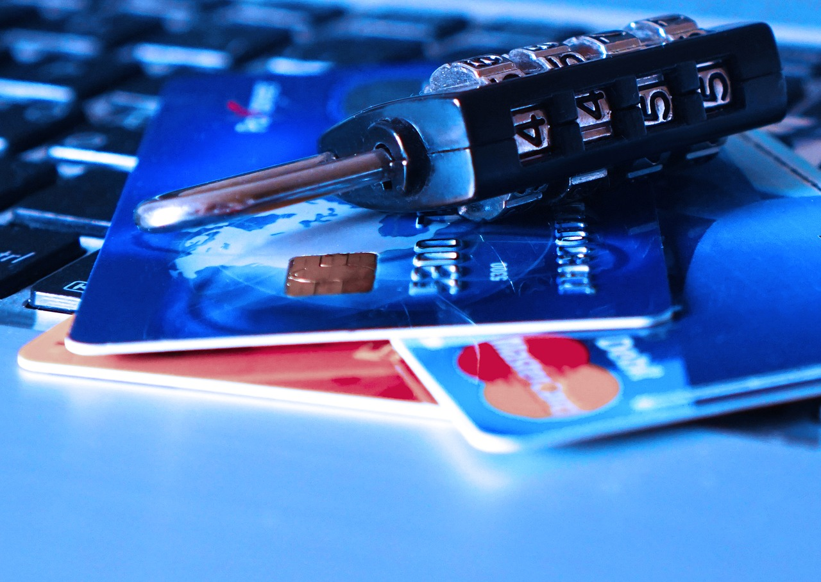
“IT IS EASIER TO TAKE ORDERS OVER THE NET”
Notes:
The retailer who took an order over the phone without any secondary verification. i.e. the additional security box that pops up when buying some goods on the internet; or where a payment is made with a VISA over the phone - transferring the purchaser over to a chip and pin machine. We are seeing scenarios where clients have taken orders, delivered goods, the money has then been settled by the VISA or card providers. Then a few months later the Card provider returns to the Insured to renege on the payment as it appears the purchaser did not purchase these goods. Our retailers issue being that they have confirmed payment without following the secondary verification. One client thought they'd concluded a £180,000 sale - only to be advised six months later that the purchaser had nothing to do with his purchase. The Insured had no secondary checks and this led to the card providers refusing to honour the sale. Second scenario; The scenario where a gang or team of fraudsters make multiple small purchases using a number of cloned cards. The insured then releases 1000 sales of £200 each. It is discovered that the Insured has been the victim of an attack by a gang of fraudsters. Again, they have not carried out any secondary checks.

Slide 23
FISHING or PHISHING? And now SMISHING!!!
Notes:
A client received an e-mail purporting to be from one of the major banks. It gave details of a new 'deal'. It stated - do not trust this e-mail - log in via normal route. The client clicked on the link and reviewed the finance deals that were available. During this visit to the site he entered in their account details - logging in and using password etc. It transpires that the senders of the e-mail had included a virus which allowed them to mirror the keying strokes. The fraudsters then entered the Insured's account and transferred £130,000. The loss is currently being considered albeit the bank is considering whether they are liable - there appears to be an issue that the bank are uncomfortable with and they may make good this loss. An interesting scenario which has still to pan out. Covered under Crime - yes. Covered under Cyber - would seem to be.

Slide 24
COMMERCIAL CRIME COVER IS VITAL
Commercial Crime has a broad Insuring Clause
RSA Commercial Crime – Insuring Clause reads – criminal, fraudulent or dishonest taking ‘by any person’
Cyber frauds are unlikely to be covered under Fidelity wordings or under ‘Crime’ extensions to Management Protection contracts
Cyber wordings are evolving – on Theft cover – be careful to read the terms and conditions
Be cautious on ‘knowingly surrendered’ exclusions – these will really impact the cover where an Insured has been duped
Be cautious on ‘social engineering’ exclusions or sub limits
The Devil is in the detail

Slide 25
WHAT BARRIERS DO WE HAVE IN SELLING CYBER AND COMMERCIAL CRIME?

Slide 26
BE RESILIENT – CLIENTS MAY TAKE THIS APPROACH

Slide 27
WHATS NEXT?

Slide 28
WHAT NEXT?
This is PROFESSIONAL ADVISE
Our clients businesses have EVOLVED – have we?
Don’t wait for your client to ask, or someone else will
Resiliency is the key – both for the insurance industry and our clients
EU GDPR will be the ‘EUREKA’ moment for Cyber – 25th May 2018
ONLY
IMAGERY AVAILABLE VIA BRAND CENTRE
CII Summary

Slide 29
questions

