Slide 1
The insurance implications of Ogden
Simon Baker
Head of Commercial AXA Insurance
Notes:
First of all, I would like to thank Axa insurance for giving rradar the opportunity of bringing you this webinar in which we will be looking at the implications of the recent reduction in what is known as the discount rate.

Slide 2
Objectives
Discuss the background to the discount rate
Explain the insurance market issues this raises
How to manage client expectations
How to negotiate and working a hard market
Practical assistance available
Notes:
Today’s objectives are
Discuss the background to the discount rate
Explain the insurance market issues this raises
How to manage client expectations
How to negotiate and working a hard market
Practical assistance available

Slide 3
The background to the discount rate…
Notes:
The background to the discount rate
The discount rate also known as the Ogden rate is an integral part of the actuarial approach when calculating personal injury damages.
As is well known in the event of an injury the claimant is entitled to receive adequate compensation for the injuries they have received.
Traditionally this has been in the form of a single lump sum payment which then has to last for the duration of the claimant’s life. The award is set so as to put the claimant in the same financial position as they would have been had they not been injured.

Slide 4
The compensation has to take into account matters such as :-
Pain and suffering
Future loss of earnings
Future care costs
Other financial support
Driving
Caring for dependents
Prosthetics
Legal and professional fees
Multiplier applied to annual future losses
Lump sum can be invested
Discount avoids over compensation
Notes:
The compensation has to take into account matters such as :-
Pain and suffering
Future loss of earnings
Future care costs
Other financial support
Driving
Caring for dependents
Prosthetics
Legal and professional fees
This is achieved by way of applying a multiplier to the amount for annual future losses. It follows that when assessing these factors such as age, retirement age and life expectancy need to be taken into account.
Many of those costs outlined may not be incurred until some future date but as that the lump sum payment is made at the time of settlement the claimant does have the ability to generate an additional return by investing that lump sum payment.
In these circumstances there can be over compensation.
It was for this reason that the settlement amount is then discounted or reduced by the interest the claimant can expect to earn.

Slide 5
Notes:
It takes it’s name from Sir Michael Ogden QC who in 1982, headed the working party that developed the actuarial tables to quantify damages in fatal accident and personal injuries cases. Known as the Ogden Tables, these are now used by all courts in fixing damages.

Slide 6
Notes:
Interestingly, the first edition of the Ogden table had this to say in the explanatory notes :
When it comes to the explanatory notes, we must make sure that they are readily comprehensible.
We must assume the most stupid circuit judge in the country and before him are the most two stupid advocates.
All three of them must be able to understand what we are saying.
Whether they achieved that is a matter of opinion but I do know that they run to over 70 pages.

Slide 7
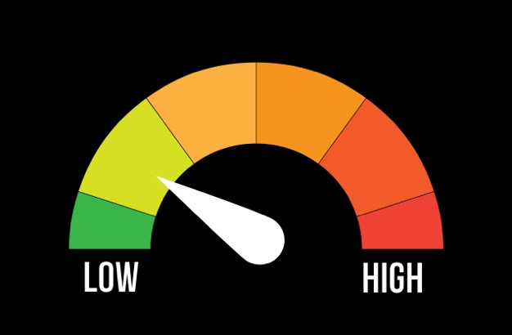
Wells v Wells (1998) - low risk investment strategy
How the claimant actually invested that damages was irrelevant.
Notes:
In 1998 the House of Lords in the case of Wells versus Wells ruled that a claimant should be assumed to invest damages in low risk index linked government stocks and at that time the rate of return over a three-year period was 3% and the discount rate was set at that level.
In the same case the House of Lords made clear that how the claimant actually invested that damages was irrelevant.
The decision of the House of Lords was based upon the thinking that claimants in personal injury cases were in a different position as ordinary investors and would accordingly be prudent in their investment strategy - they needed the certainty of future money to cater for their future needs and could not afford any shortfall.
The law makes clear that claimants must be treated as risk averse investors, reflecting the fact that they are financially dependent on this lump sum, often for long periods or the duration of their life.
The decision of the House of Lords was based upon the thinking that claimants in personal injury cases were in a different position as ordinary investors and would accordingly be prudent in their investment strategy - they needed the certainty of future money to cater for their future needs and could not afford any shortfall.
The law makes clear that claimants must be treated as risk averse investors, reflecting the fact that they are financially dependent on this lump sum, often for long periods or the duration of their life.
The discount rate was reduced in 2001 (2002 in Scotland) to 2.5% level.
This was reduced earlier this year to -0.75% and it is this adjustment that is causing major shock waves throughout the insurance industry.

Slide 8
The insurance market issues this raises
Notes:
The reduction in the discount rate has an immediate impact on motor and liability insurance lines as well as other public authorities that pay compensation such as the NHS.
This is because compensation payments will need to be significantly increased to allow for the lower investment returns that lump sum brings.

Slide 9
For example the following are taken from various readily available sources
@ 2.5% Ogden rate @ -0.75% Ogden rate
Age Gender Claim size Claim size Claim size
20 M £ 5,000,000 £ 9,904,348 + 98%
47 M £ 8,500,000 £14,999,454 + 76%
27 F £ 6,500,000 £13,949,421 +115%
30 F £12,000,000 £22,997,255 + 92%
10 M £10,000,000 £26,521,997 +165%
70 M £ 1,100,000 £ 1,388,607 + 26%

Slide 10
Notes:
Insurers need to keep their head above water !
As you are no doubt aware, insurers have a statutory and regulatory obligation to carry adequate reserves as well as meeting solvency requirements. Given that the revised discount rate will lead to greater compensation payments all insurers are having to review their current claim reserves.

Slide 11
The consequences of not doing so are clear.
Independent
Quinn
Gable
?

Slide 12
Ageas announced it will incur a €55 million hit in its fourth-quarter 2016 results
Aviva posted an exceptional charge of approximately £385 million as results of the change
Direct line took a hit of £230 million to its full year results
QBE took a hit of £129 million
Admiral took a hit of £105 million
Immediate response in the press

Slide 13
Deloitte analysing the public statements made by insurers have estimated a total market impact on reported results of £2 billion which equates to some 18% of the motor market written premium.
Across the industry, the overall cost across all claims that are effected is estimated at £7 billion with ongoing annual costs of £1.2 billion thereafter.
There is also likely to be increase in the cost of reinsurance
So what does this mean in practice?

Slide 14
As such all policyholders with liability cover will be effected.
Motor
Motor Trade
Casualty
Construction

Slide 15
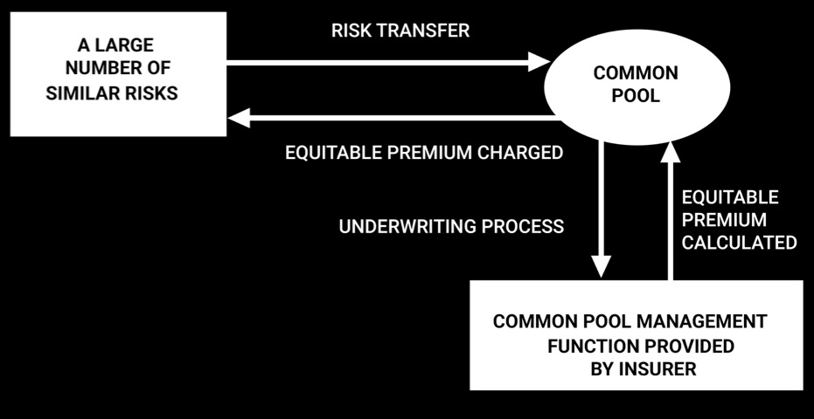
The Insurance concept
Notes:
First of all, the revising of current reserves
As we all know, insurance is a risk transfer mechanism in which the policyholder transfers an unknown risk to the insurer for a known premium. In its simplest form, the premium is put into a common pool out of which claims are paid.
It relies upon the principle of the contributions of the many pay for the claims of a few.
Clearly the pool is a finite sum of money and if more money has to be taken out to pay claims or put aside for a later day, in other words reserve, then all policyholders will have to pay increased contributions i.e. a higher premium to keep the pool topped up.
My understanding is that on a market wide basis the reduction in the Ogden rate will produce in premium increases of between 6 and 10%.
If one assumes an average rate increase of 8% there will, of course, be winners and losers but the fact remains that all policyholders with a risk of personal injury will feel the impact of the reduction in the Ogden rate.

Slide 16
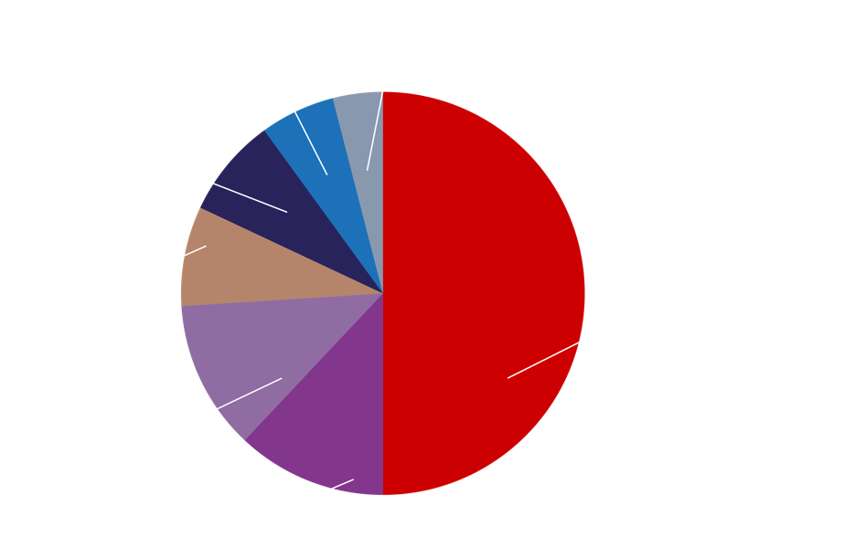
Components of Technical Price

Slide 17
Increase in IPT
10% to 12% - June 2017

Slide 18
Notes:
Mohammad Khan, UK general insurance leader at PwC, said: "As a direct result of this change, we anticipate an increase of £50-£75 on an average comprehensive motor insurance policy, with higher increases for younger and older drivers – potentially up to £1,000 for younger drivers (18-22 year olds) and a rise of up to £300 for older drivers (over 65 years old).
Whilst the government is to review the framework under which the rate is set and a consultation has been launched this is likely to focus on whether the rate should be set by an independent body; whether more frequent reviews would improve predictability and certainty for all parties; and whether the methodology appropriate for the future.
It is uncertain whether the actual rate will be adjusted.
Taking all of these factors into account it is fair to say that we will be entering a period of significant premium increases or a hard market as insurers begin the process of repositioning their individual books of business.

Slide 19
How to manage client expectations
Notes:
I suspect that many younger brokers may never have experienced trading in a hard market and it does require a different skill set.
Having to explain to a client why their premiums are increasing despite having a claim free record is never an easy task but it is certainly more difficult when they retort that the risk is unaltered on 12 months ago, for example so why should they pay for other people’s mistakes ?
The managing of client expectation is therefore key and being armed with reasons why the market as a whole is increasing premiums does go some way to softening the blow as it were.

Slide 20
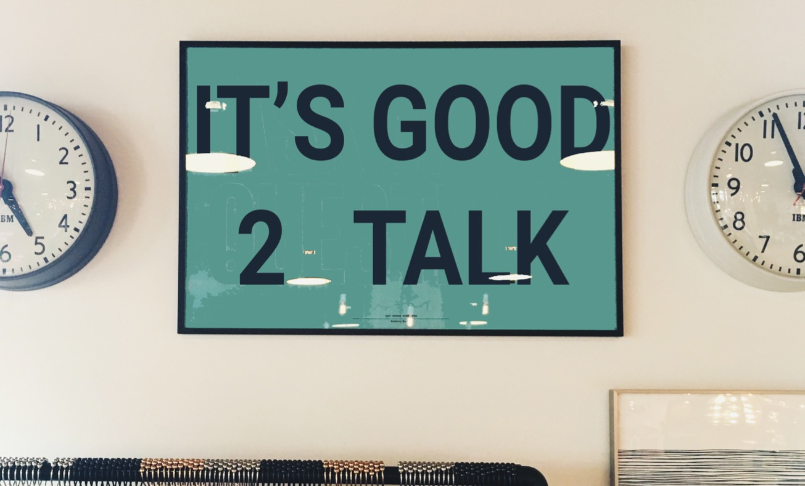
Notes:
Indeed, you may have already seen articles appearing in the insurance press of the need to engage with client’s sooner rather than later.
Being confronted with premium increases many clients will, perhaps, approach other brokers for alternative quotations and the area of managing client expectation can be pivotal. So for example agreeing with the client the tactics to be adopted and keeping them informed of developments can pay dividends.
Certainly, risks may well need to be rebroked and this itself will bring additional challenges.

Slide 21
Perception
vs
Reality
Notes:
Insurers will undoubtedly be taking a more cautious approach in new business particularly those they perceive to be higher risk or having an adverse claims experience.
This does, of course, make brokers market presentations all the more crucial and brokers can certainly add value to the overall insurance placing process.
Brokers certainly will need to fully understand their clients business and depending on the internal setup may want to consider including the account handler in the client visit allowing them to see for themselves the clients premises and business in action.
Speaking personally it helped me enormously as an account handler having been to a client’s premises. For me it certainly meant I was able to produce a better presentation being able to fully describe the clients business, having seen it myself rather than having to rely upon notes from an account executive and some well chosen photographs.

Slide 22
Focus on why the underwriter should consider that risk :-
future growth opportunities
positive management processes
strong claims history
highly trained personnel
Notes:
One of the aims of the Insurance Act introduced last August was to encourage greater participation by the insurer is seeking out material circumstances - in other words asking questions. I feel that the forthcoming market will require further collaboration between insured, broker and insurer to understand the risk well enough to come to an agreement as to the terms and pricing

Slide 23
Notes:
For Employers Liability cases it may well be the case that underwriters will focus more on the client’s attitude towards health and safety not only in terms of policies and processes but how these are actively managed by policyholder. In other words, the culture of the business.
I remember the situation in the early 2000’s when a small manufacturing business faced a premium increase of 300% in their EL premium equating to a premium of £115,000 compared to a mere £38,000 a year before
This particular business had, unfortunately, picked up the bill for a number of vibration white finger claims following their laudable decision to employ and retrain former mine workers. unfortunately, this did distort their email claims history.
I clearly remember the difficulty in having to break the news to the client and despite the fact that I had covered what I thought was the entire market they did insist on obtaining alternative quotations whilst this was to no avail we where viewed as the bad guy.
Incidentally, that sort of premium increase meant that the client in question had to make a number of workers redundant in order to pay for premium increases.
The next period within the market cycle will certainly test the broker client relationship and as I said earlier it does require a totally different skill set.
Communication with the client is key.

Slide 24
Broking in a hard market - different skill set.
Communication with the client is key.
The arts or skill of negotiation will once again come to the fore.
Tactics and strategy - within the business and with each individual client.

Slide 26
Notes:
For example, a few months ago I was speaking to an underwriter querying whether the introduction of the Insurance Act had resulted in better quality presentations.
She replied that in her opinion the standard had in many cases dropped citing an example in which a broker requested a commercial combined insurance quote based on a copy of the existing policy schedule and reference to the clients website which could be accessed for additional information.
Not only was I appalled at such a lack of professionalism but the mind boggles at the fact that there are markets out there that may well have provided quotations on such limited information
Whilst that is perhaps an extreme example of not what to do it is indicative of some of the poor practices which the next period will no doubt be marginalised.
Don’t just include the claims experience but include an analysis – what did the client do following this loss or what did they learn from that loss. Hopefully, they do review losses and implement changes where necessary.

Slide 27
Notes:
For example, in the manufacturer I mention earlier, future VWF claims were mitigated by the purchase of low vibration grinders, changing working practices but a key feature was that the miners no longer worked for the company so the source of the claims had diminished or possibly disappeared – a crucial fact.
By way of background, the miners had a pre disposition for VWF stemming from the day in the mining industry but they subsequently dragged in subsequent employers, particularly as even back then there were personal injury lawyers actively seeking out former mineworkers in order to make claims.

Slide 28
The limit of
liability
Notes:
Brokers will need to assess the adequacy of liability limits
There will also be a risk of liability under insurance given the possibility that existing claims may be settled at figures which exceed the policy limit and accordingly policyholders will have to fund any shortfall.
Large losses should therefore be reviewed and the whole question of policy limits will deed to be raised with all clients. When reviewing policy limits you will need to be aware that the size of a business is no longer a guide to the level of cover required for example a firm employing a younger workforce with perhaps numerous apprentices may need a higher policy limit than one with a more middle-aged workforce.
Consideration will also need to be given as to whether the standard employers liability limit of £10 million remains adequate
whilst the number of £10 million plus claims are small there is a an expectation that insurers will see more claims at or indeed above this level.

Slide 29
Any Questions ?
Simon Baker
Head of Commercial AXA Insurance
Notes:
First of all, I would like to thank Axa insurance for giving rradar the opportunity of bringing you this webinar in which we will be looking at the implications of the recent reduction in what is known as the discount rate.

