Slide 1
The Insurance Institute of Halifax 18 October 2017
Paul Ryman-Tubb ACII Chartered Insurer
Chief Technical Officer, MIB

Slide 2
The Insurance Institute of Halifax
MIB – ‘a brief history’
How MIB is tackling the problem of uninsured driving
The Road Traffic Act, Article 75 – a ‘rough guide’
Assisting victims of uninsured and ‘hit and run’ drivers
Recent case law – Vnuk, Holden, Cameron, Fidelidade
Current / future challenges

Slide 3
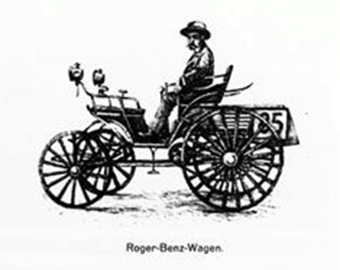
The Insurance Institute of Halifax

Slide 4
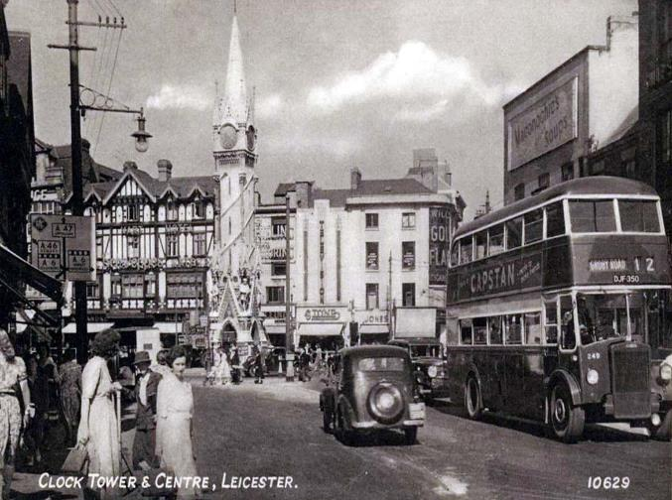
The Insurance Institute of Halifax

Slide 5
The Insurance Institute of Halifax
The Directives –
“Each member state shall set up or authorise a body with the task of providing compensation … for damage to property or personal injuries caused by an unidentified vehicle or a vehicle for which the insurance obligation … has not been satisfied”
[2nd Motor Insurance Directive 1984]

Slide 6
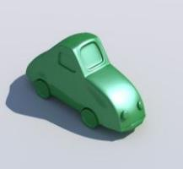
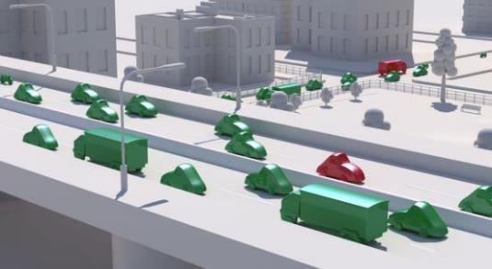
The Insurance Institute of Halifax
Our Mission
To significantly reduce the levels and impact of uninsured and untraced driving in the UK
To deliver first-class, secure, data asset management and analytical services on behalf of our Members & the industry
To compensate victims of uninsured and untraced drivers fairly and promptly

Slide 7
MIB Services
Uninsured Driving
MIB Claim Services
MIB Non-Claim Services
Non MIB Managed
Services
National Guarantee Fund
Uninsured Drivers Agreement
Police Services
Untraced Drivers Agreement
UK Green Card Bureau
askCUE.co.uk
Police Helpline
UK Information Centre
Continuous Insurance Enforcement (CIE)
UK Compensation Body

Slide 8
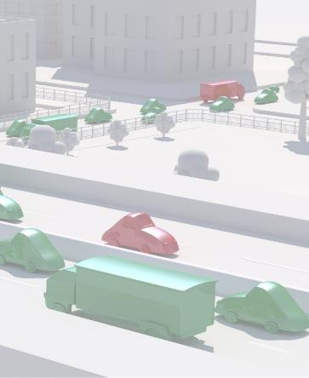
The Insurance Institute of Halifax
Uninsured driving in numbers
Total cost of uninsured motoring: £400 million
Total UK vehicles: 39.2 million
Number of uninsured vehicles: 1 million
Injured victims: 29,000
Deaths: 120

Slide 9
The Insurance Institute of Halifax
Continuous Insurance Enforcement (CIE)
Launched in June 2011
3 million letters issued
More than 135,000 successful prosecutions in court
More than 900,000 Fixed Penalty Notices

Slide 10
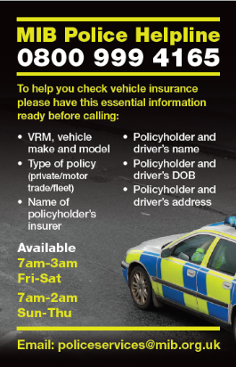
The Insurance Institute of Halifax
What are the results?
Police Helpline total enquiries:
2013: 195,000
2014: 127,000*
2015: 132,000
2016: 132,000
Sun-Thurs: 7am-2am; Fri-Sat: 7am-3am
“The MIB are a key partner, for the Police service, in tackling uninsured driving. The Police Helpline and MIB assisted officers in seizing over 146,000 vehicles in 2016, an increase of over 20% on 2015, which was invaluable in improving road safety and tackling criminality”
Anthony Bangham - National Police Chiefs Council (NPCC) lead for Roads Policing

Slide 11
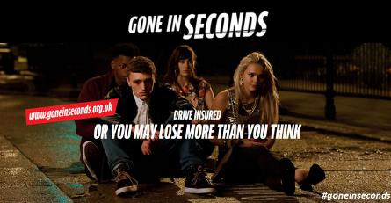
The Insurance Institute of Halifax
What are the results?
Changing uninsured driving together
Uninsured vehicles seized:
2005: 45,000
2006: 78,000
2007: 150,000
2008: 185,000
2009: 180,000
2010: 150,000
2011: 140,000
2012: 137,000
2013: 135,000
2014: 116,000
2015: 121,000
2016 146,000

Slide 12
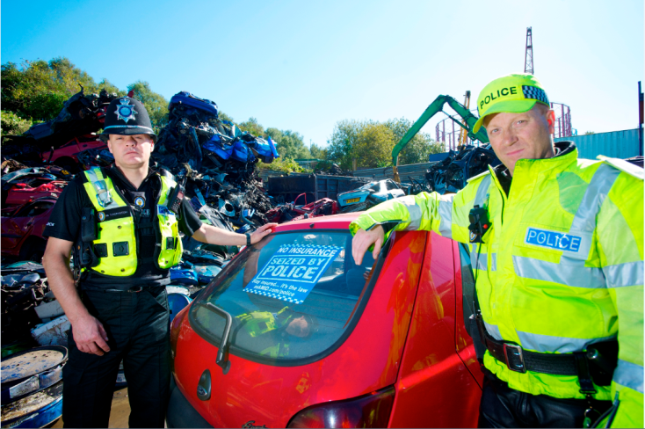
The Insurance Institute of Halifax
More than 1.5 million vehicles seized

Slide 13
The Insurance Institute of Halifax

Slide 14
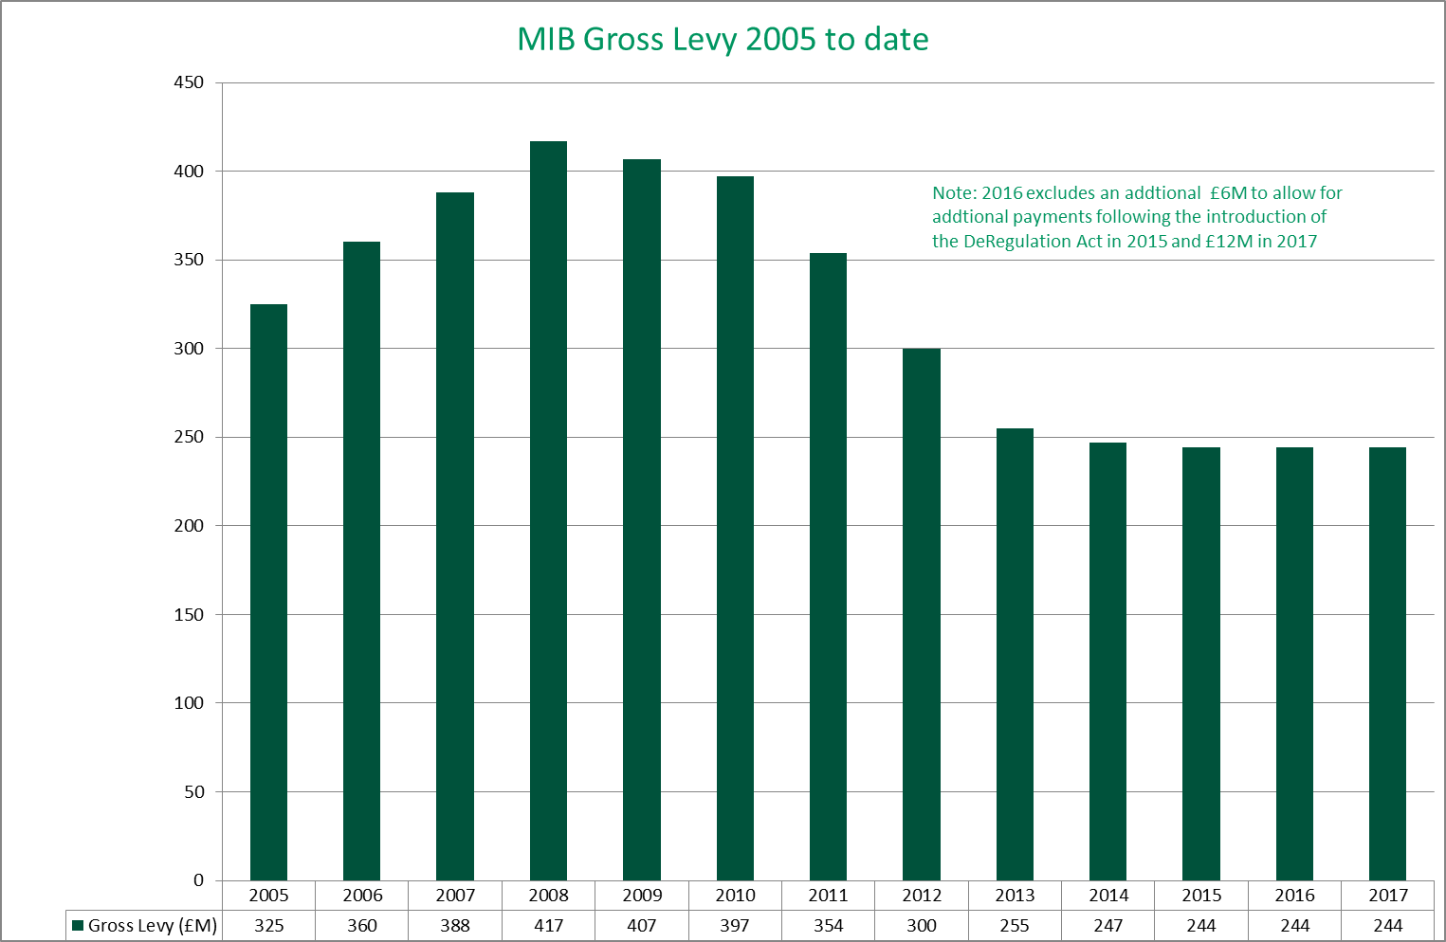
The Insurance Institute of Halifax

Slide 15
Obligations of Insurers
The Insurance Institute of Halifax
The “cascade” effect
Contract
RTA
Article 75
MIB – Guarantee fund

Slide 16
Part VI of the RTA 1988 Criminal offence to cancellation
The Insurance Institute of Halifax
S143 – obligation to insure and creation of offence
S145 – requirements in respect of policies
“arising out of the use of a vehicle on a road”
S151 – insurers obliged to pay where:
Liability would be covered if insured “all persons” [151(2)(b)]
S151 applies even if:
Driver unlicensed [151(3)]
Avoided, avoidable, cancelled or cancellable [151(5)]
But may cease – see later
No liability to a passenger in a stolen vehicle [151(4)]

Slide 17
Part VI of the RTA 1988
The Insurance Institute of Halifax
Cancellation [s152(1)]
Simplified by the Deregulation Act 2015
30 June 2015 – a date to remember

Slide 18
Part VI of the RTA 1988
The Insurance Institute of Halifax
Avoidance – s152(2)
If misrepresentation or non disclosure
Need to issue proceedings and ask court to verify (issue declaration)
Article 75 liability remains unless done before accident
Fidelidade (Casse Suisse) – a ‘game changer’?

Slide 19
Article 75
The Insurance Institute of Halifax
What is Article 75?
Rules to determine when an insurer pays an uninsured case
Dispute resolution mechanism built in
Binding on insurers
Part of MIB’s Articles of Association (No. 75)

Slide 20
Article 75 Main Provisions
The Insurance Institute of Halifax
Insurer is A75 even if ...
Fraud / misrepresentation
Backdated cover
No annual certificate issued
Use outside the scope
and is not A75 when...
Cancelled & MID updated before accident
Transfer of interest
Certificate stolen / forged
Declaration obtained before accident

Slide 21
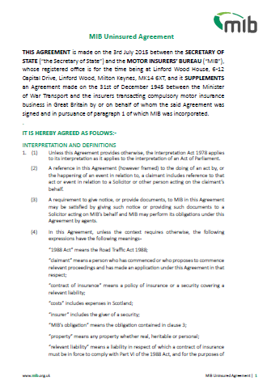
The Insurance Institute of Halifax
Uninsured Agreement 2015

Slide 22
The Insurance Institute of Halifax
Claims Handling at MIB
The Uninsured Drivers’ Agreement
MIB obligations – link to legal obligations
Exclusions:
Repaying insurers (subrogation)
‘Subsidiarity’
Damage to uninsured vehicles
Passengers who know …
Litigation
Recovery from uninsured driver

Slide 23
The Insurance Institute of Halifax
Claims Handling at MIB
The Untraced Drivers’ Agreement 2017
Inquisitorial system
MIB investigates
Police report
Medical records – A&E often revealing
Interviews / statements
Property damage – yes but …
Reporting to Police
Claimant obliged to assist
Disputes – arbitration system
Contribution to legal costs

Slide 24
The Insurance Institute of Halifax
Recent case law
Holden v Pilling & Phoenix Engineering
‘What’s the use’ ?
How far does it go?
Cameron v Hussain
An exercise of discretion or a ‘fraudsters’ charter’?
Vnuk …

Slide 25
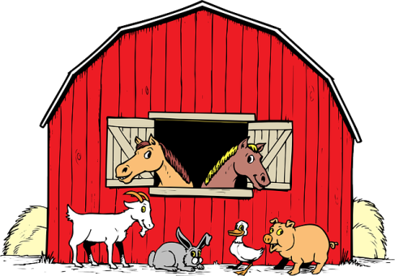
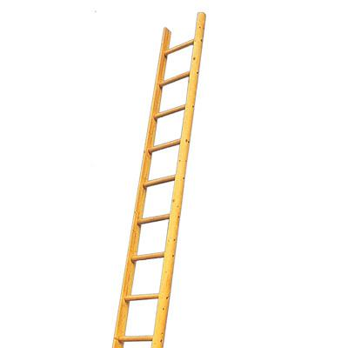
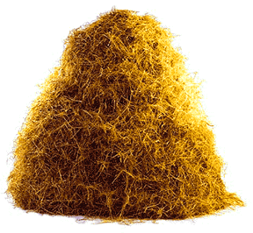
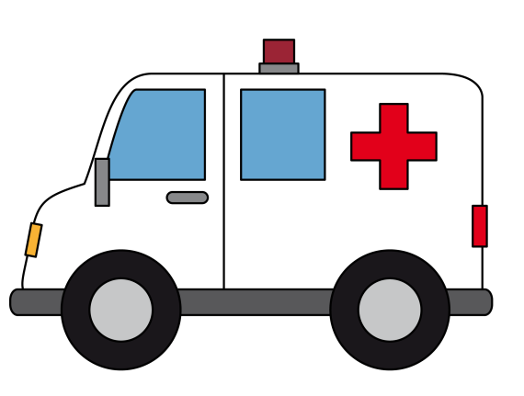
The facts of the case
The Insurance Institute of Halifax

Slide 26
The Insurance Institute of Halifax
Legislative background
“a person must not use a vehicle on a road or other public place …” (s143 RTA 1988)
Member states required to have compulsory insurance in respect of the use of vehicles normally based in its territory (Article 3)
“Motor vehicle means … a mechanically propelled vehicle intended or adapted for use on roads” (s185 RTA 1988)
“Vehicle means any motor vehicle intended for travel on land and propelled by mechanical power but not running on rails, and any trailer whether or not coupled” (Article 1.1)

Slide 27
The Insurance Institute of Halifax
Damijan Vnuk
Road use only?
“the Commission is of the opinion that that provision applies to the use of vehicles, whether as a means of transport or as machines, in any area, both public and private…” (Para 35)
Motor vehicle?
- see definition in Directive
“the concept of ‘use of vehicles’ in that article covers any use of a vehicle that is consistent with the normal function of that vehicle” (Para 59)

Slide 28
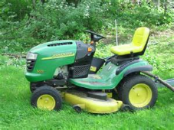
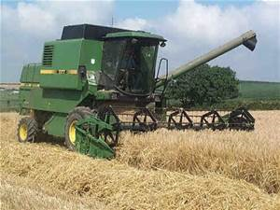
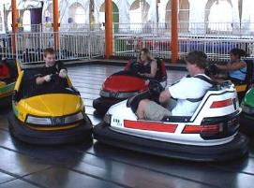
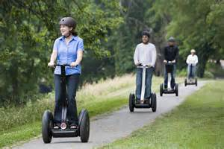
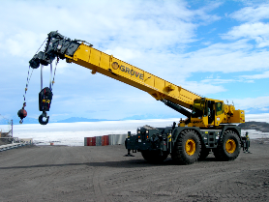
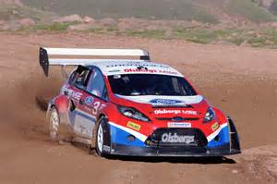
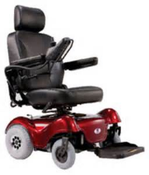
The Insurance Institute of Halifax

Slide 29
The Insurance Institute of Halifax
Concerns/fixes
Enforcement - public message
Fraud
Motor sport and other risks
The Directive
The “Inception impact assessment”
The ‘in traffic’ solution
“areas where the public has access”
REFIT – the last chance?
BREXIT

Slide 30
The Insurance Institute of Halifax
Current / future challenges
University of Leicester research
Brexit – cross border challenges
Terrorism
REFIT – Vnuk / insolvencies
RoadPeace JR
Public awareness
And for uninsured driving …

Slide 31
The Insurance Institute of Halifax
Our Mission
To significantly reduce the levels and impact of uninsured and untraced driving in the UK
To deliver first-class, secure, data asset management and analytical services on behalf of our Members & the industry
To compensate victims of uninsured and untraced drivers fairly and promptly

Slide 32
The Insurance Institute of Halifax
Paul Ryman-Tubb ACII
Chief Technical Officer
Email: prymantubb@mib.org.uk
Motor Insurers’ Bureau
Linford Wood House
6-12 Capital Drive
Milton Keynes
MK14 6XT
Tel: 01908 830001
www.mib.org.uk
facebook.com/driveinsured
twitter.com/driveInsured
youtube.com/driveinsured

